Slide 1
Scientific Applications of airborne lidar
Franco Marenco
ECARS 1st Summer School on Atmospheric remote sensing: challenges and applications, Bucharest, 23 May – 3 June 2016

Slide 2
What this presentation does not cover
What lidar is and how it works
How lidar signals are to be interpreted
How to invert the lidar signal to derive extinction coefficient

Slide 3
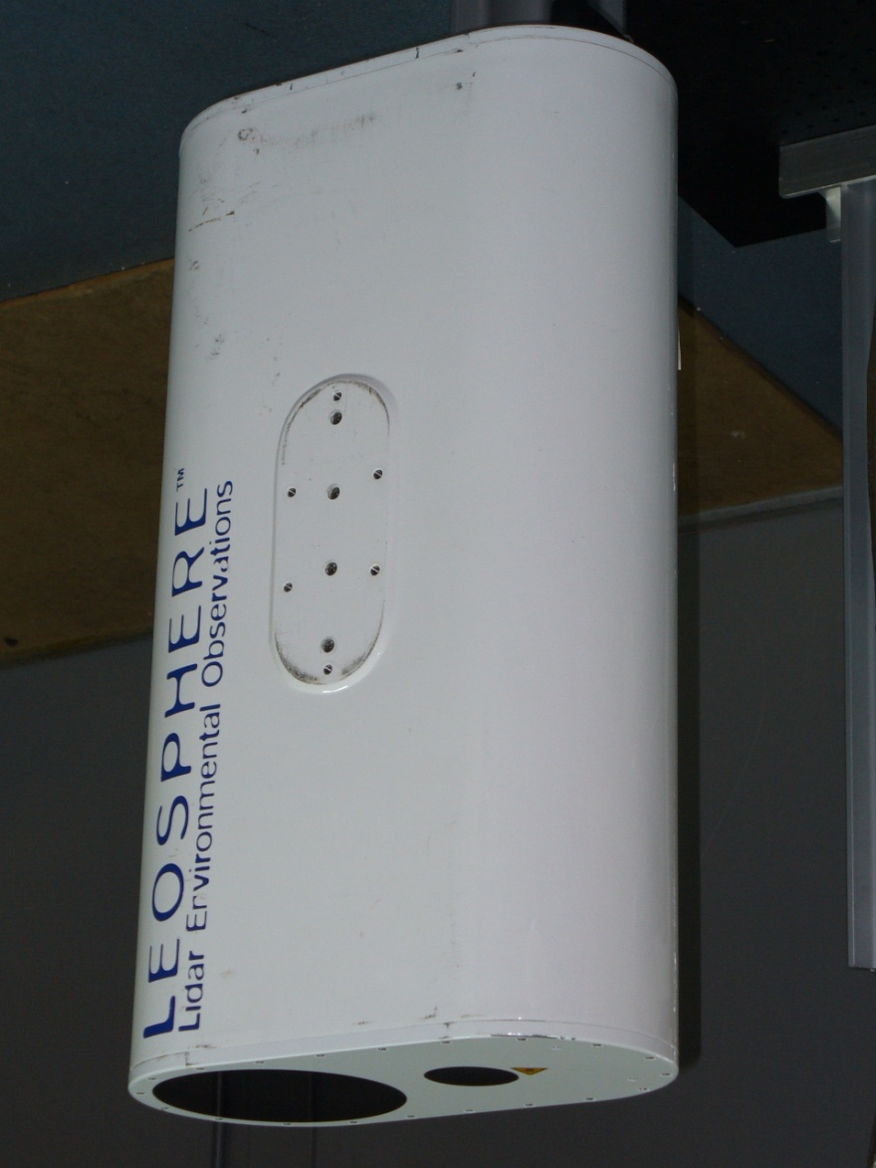
Leosphere lidar
wavelength: 355 nm
laser source: 12 mJ @ 20 Hz
receiver aperture: 15 cm
receiver bandwidth: 0.36 nm
overlap range: 300 m
vertical resolution: 1.5 m (45 m)
integration time: 2-60s
footprint: 0.3–10 km
view: nadir

Slide 4
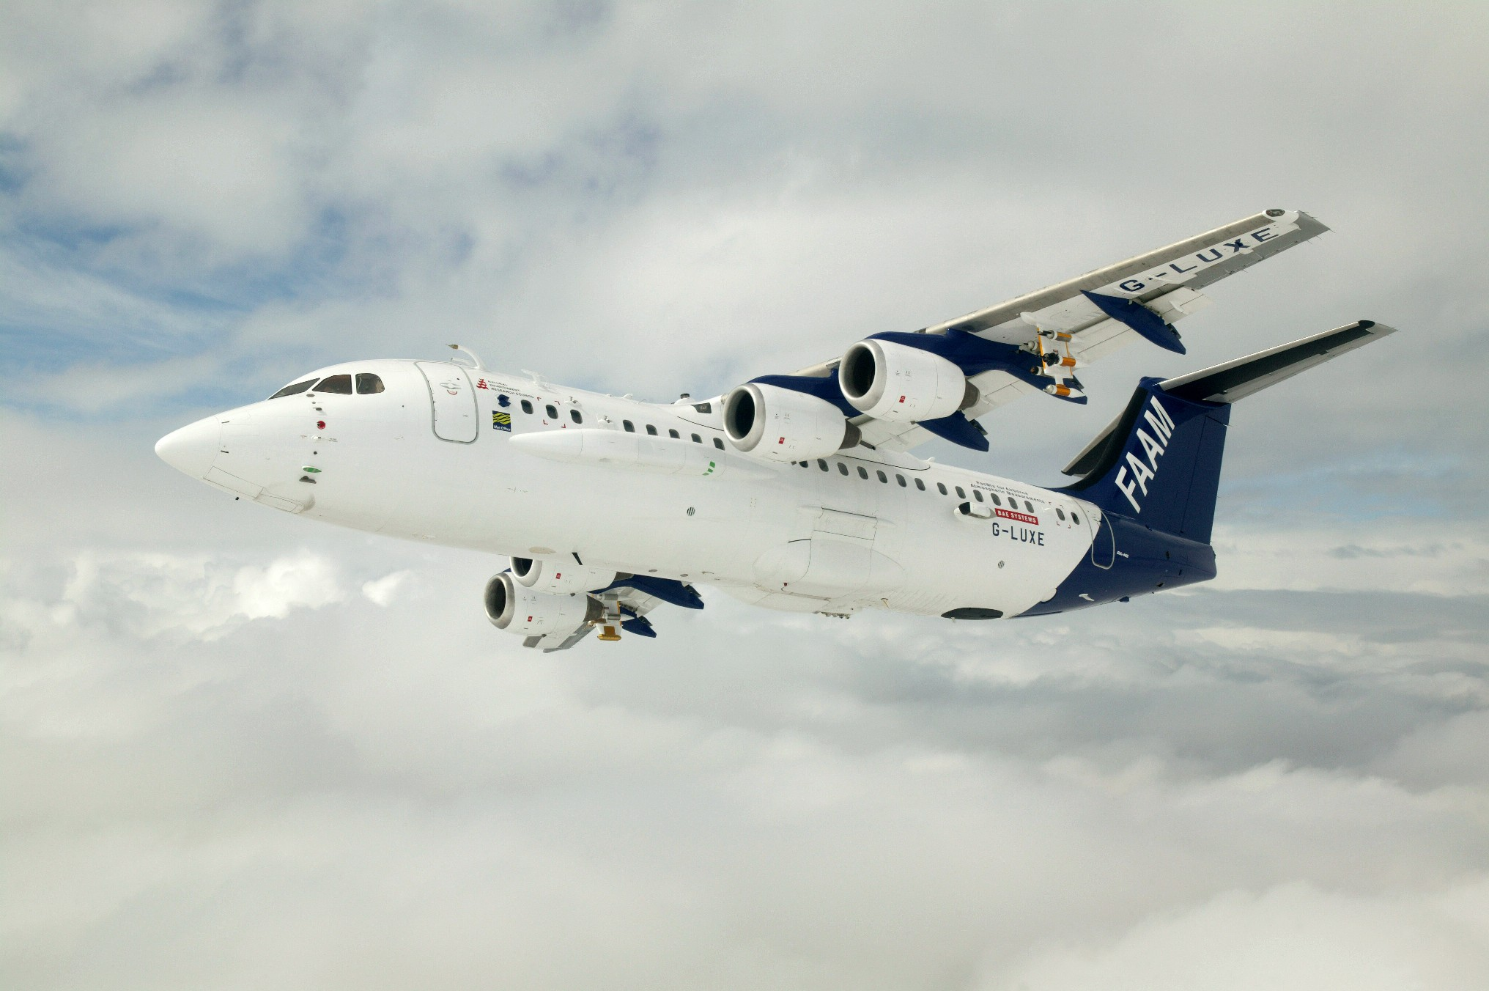
FAAM BAe–146–301 Atmospheric Research Aircraft
Upward and Forward Video Cameras
ADA on other side
SWS on other side
FAGE Inlet
CVI on other side
Air sample inlets
BBRs
SHIMS
Cloud Physics Probes
5 port turbulence probe
Total water probe
JW Liq water
Nevzerov total/liq water probe
Rosemount temp probes
Dropsonde on other side
Deimos or IR Camera
TAFTS
ARIES
BBRs
MARSS
SHIMS
Lidar
Rearward and Downward Video Cameras
Cloud Physics Probes

Slide 5
FAAM BAe–146–301 Atmospheric Research Aircraft
Major asset to the Met Office and the UK academic community
Is part of a long history (70 y) of Meteorological Research Flight
Provides independent observations of atmospheric fields
Permits to complement observations from several instruments
Model + parametrisations (UM, NAME)
Verification/validation of satellite products
Operational / Civil contingencies (e.g. volcano)

Slide 6
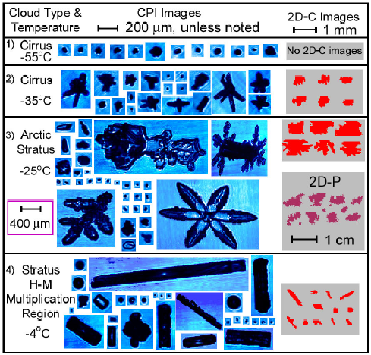
Cloud physics instruments
0.1μm
3μm
100μm
1mm
10mm
PCASP
2D-C
FFSSP
2D-P
CIP-15
CDP
PIP-100
Size Spectra
2D-S
CAPS/CIP
CAPS/CAS
SID-1
SID-2
CPI
ADA
JW - liquid
Bulk Properties
Nevzorov - liquid
Nevzorov - total
TWC - total

Slide 7
Radiometers
BBR – irradiance measurements: 0.3–3.0μm; 0.7–3.0μm; 4–50μm
Heimann – broadband infrared radiometer (8–12μm)
SWS – Short Wave Spectrometer: 0.3–1.7μm (pixel resolution 3.2 nm up to 0.95μm, 6.3 nm thereafter)
SHIMS – Spectral Hemispheric Irradiance Measurement: 0.3–1.7μm (pixel resolution 3.2 nm up to 0.95μm, 6.3 nm thereafter)
ARIES – infrared interferometer: 3.3–16μm; max OPD = 1.037cm (~ 0.5cm⁻¹) – 4800 channels
TAFTS – far infrared interferometer 10–125μm (Imperial College)
ISMAR – submillimeter radiometer 118–874 GHz (7 channels)
MARSS, Deimos – microwave radiometers 24–183 GHz (5 channels)

Slide 8
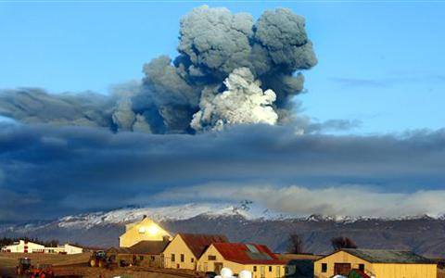
Volcanic ash (2010)

Slide 9
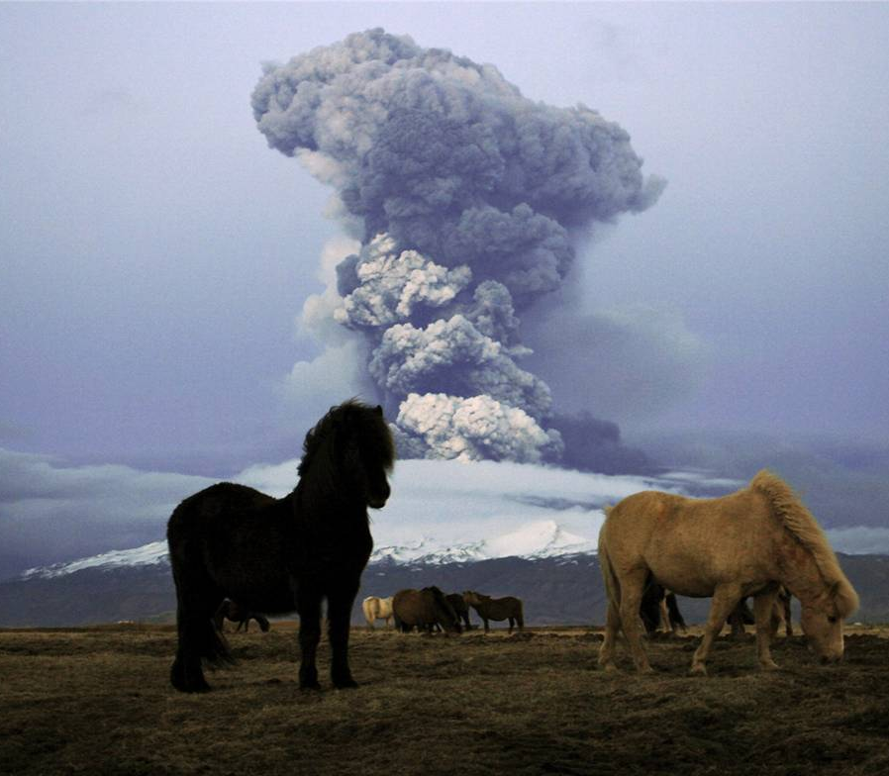
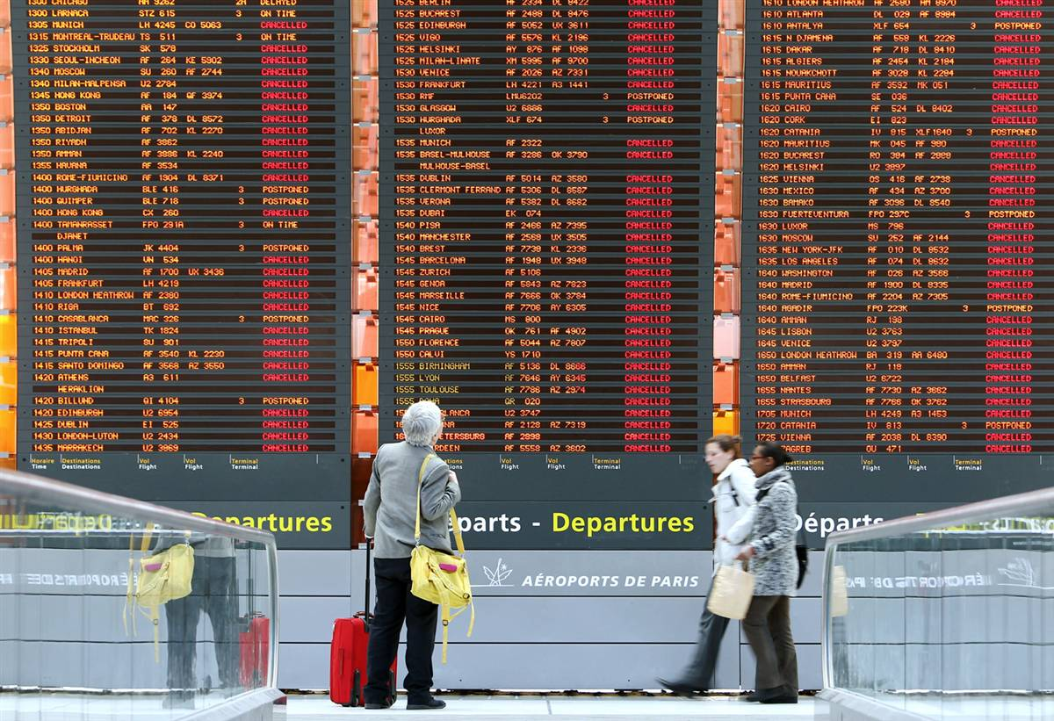
The eruption of Eyjafjallajökull
75% of European airspace closed during April 14 – 20th, 2010.
Further closures in May.
100,000 flights cancelled
10 million passenger journeys affected
Airline loses £200M/day
Global economy ~$5B
Explosive eruption began 14th April 2010, continued until ~ 23rd May
0.25 km³ of tephra ejected > 4 on volcanic explosivity index (0 – 7)
NW atmospheric flow for much of April-May 2010 → Ash over Europe!

Slide 10
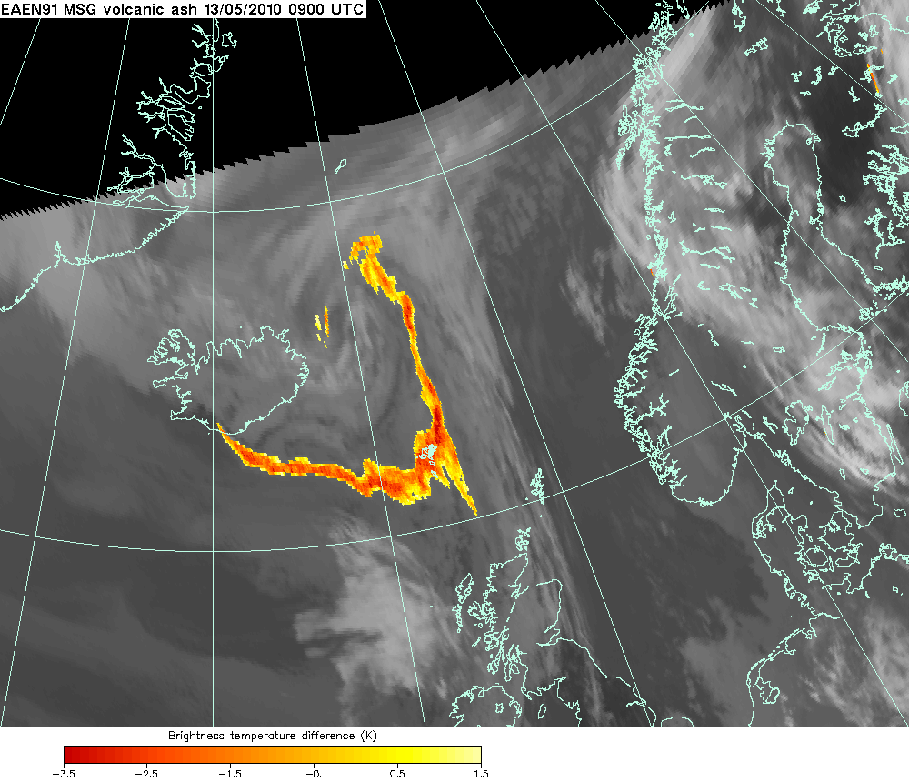
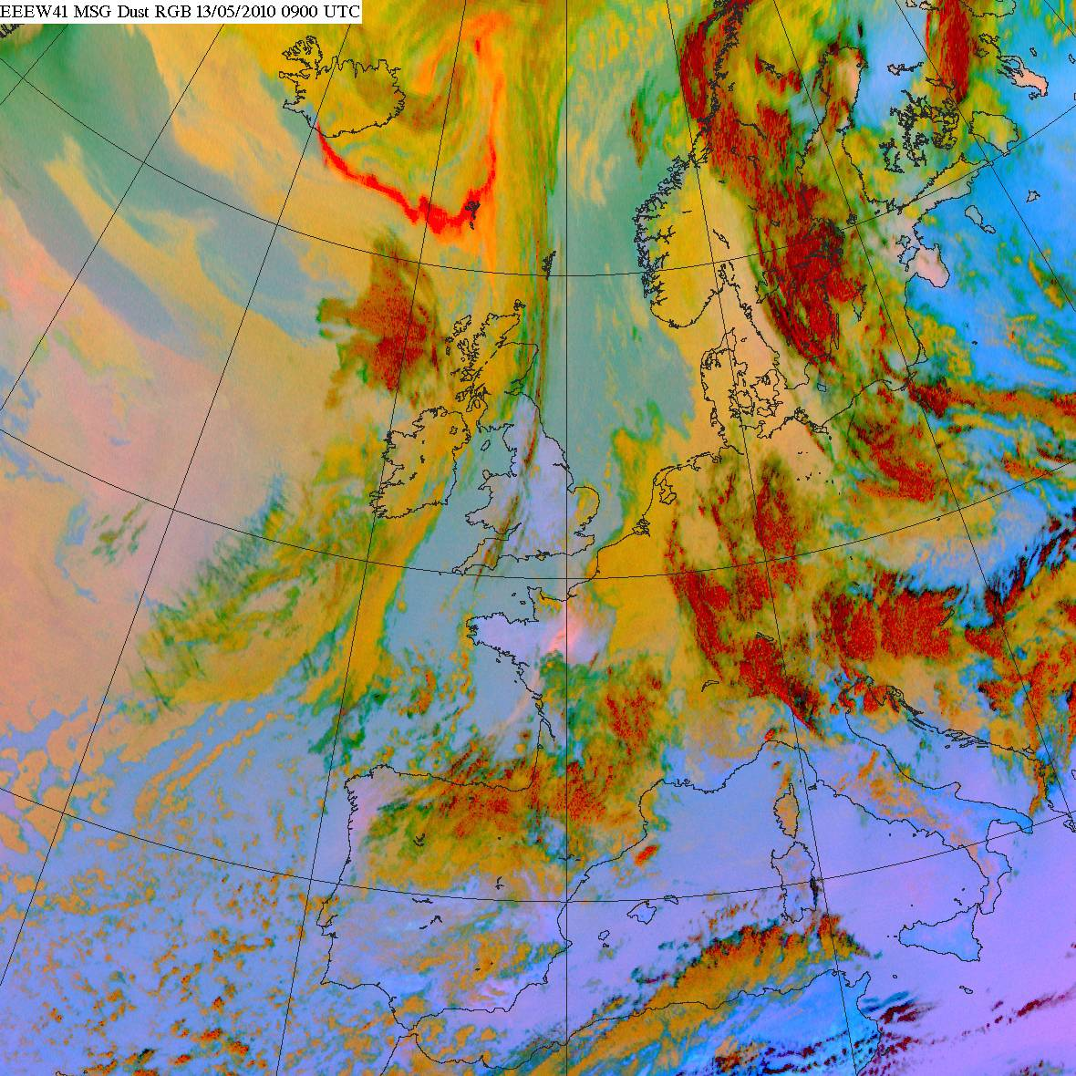
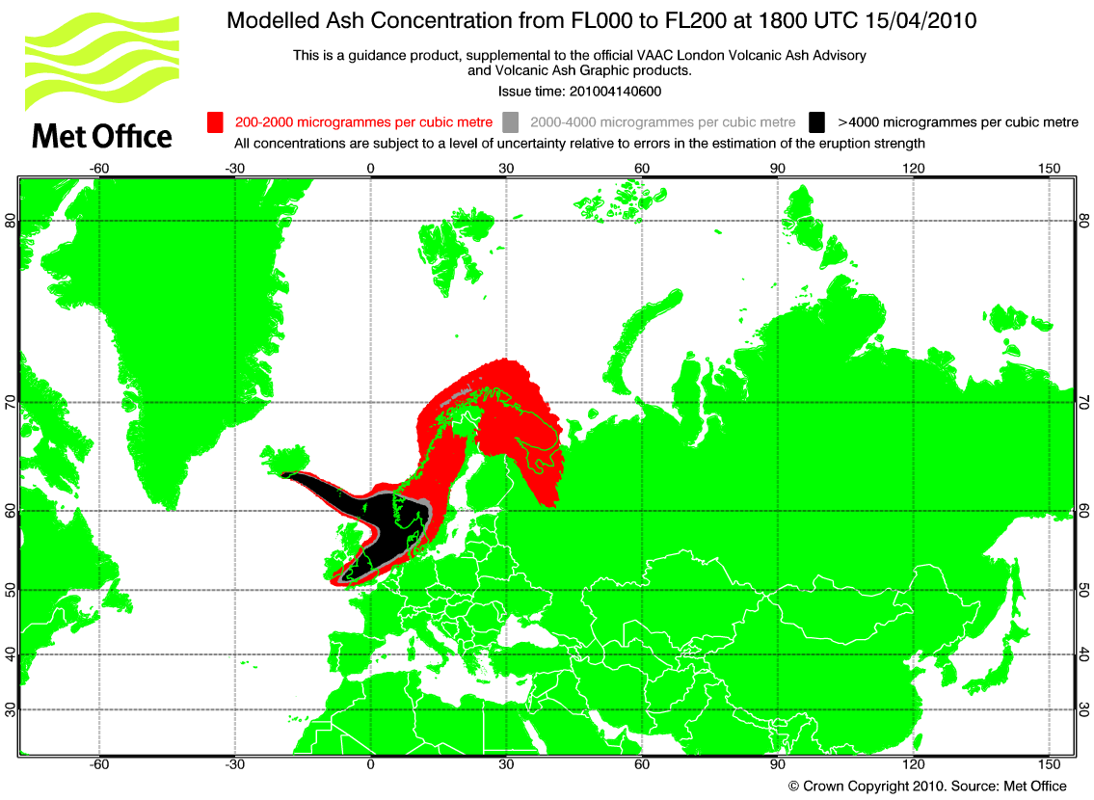
Volcanic ash: Satellite and modelling products
Improved ash
detection algorithm
Dust RGB: useful
qualitative product
NAME MODEL OUTPUT
200-2000 μg/m³
2000-4000 μg/m³
>4000 μg/m³

Slide 11
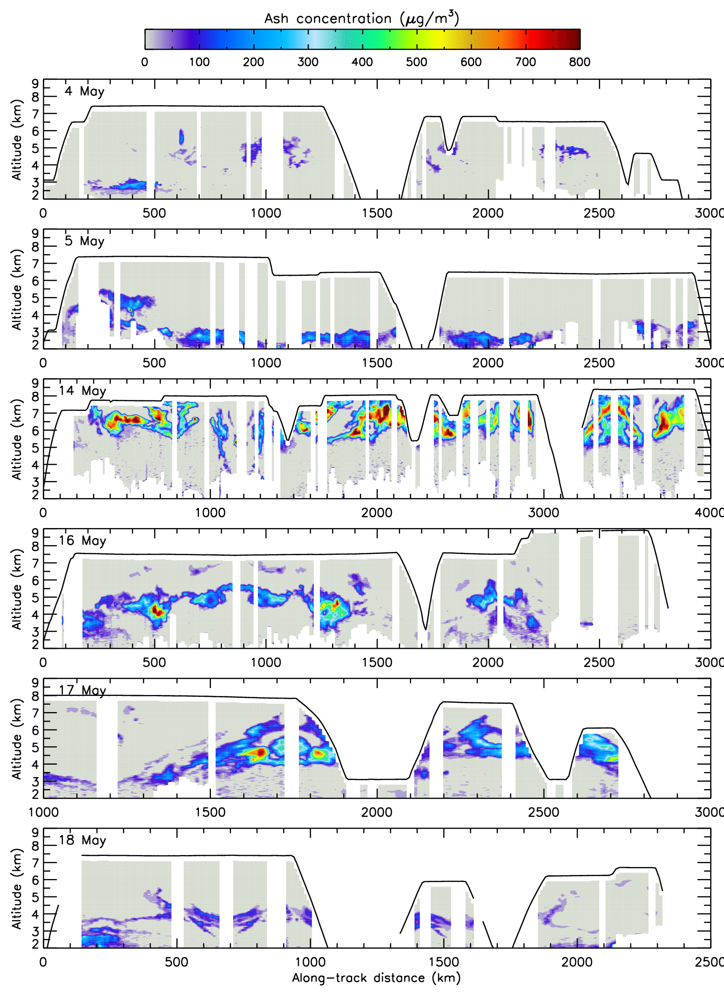
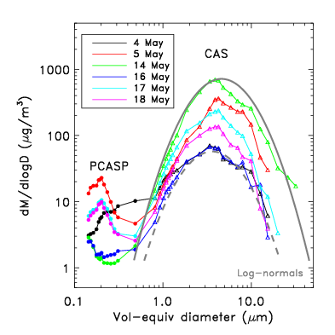
Lidar concentration estimates
Date | f_{c} | K_{ext} (m²/g)
4 May | 0.52 | 0.92
5 May | 0.72 | 0.65
14 May | 0.97 | 0.62
16 May | 0.78 | 0.82
17 May | 0.82 | 0.72
18 May | 0.75 | 0.74
courtesy of B. Johnson (MO),
and J. Dorsey + M. Gallagher
(University of Manchester)
Uncertainty: ~ factor of 2

Slide 12
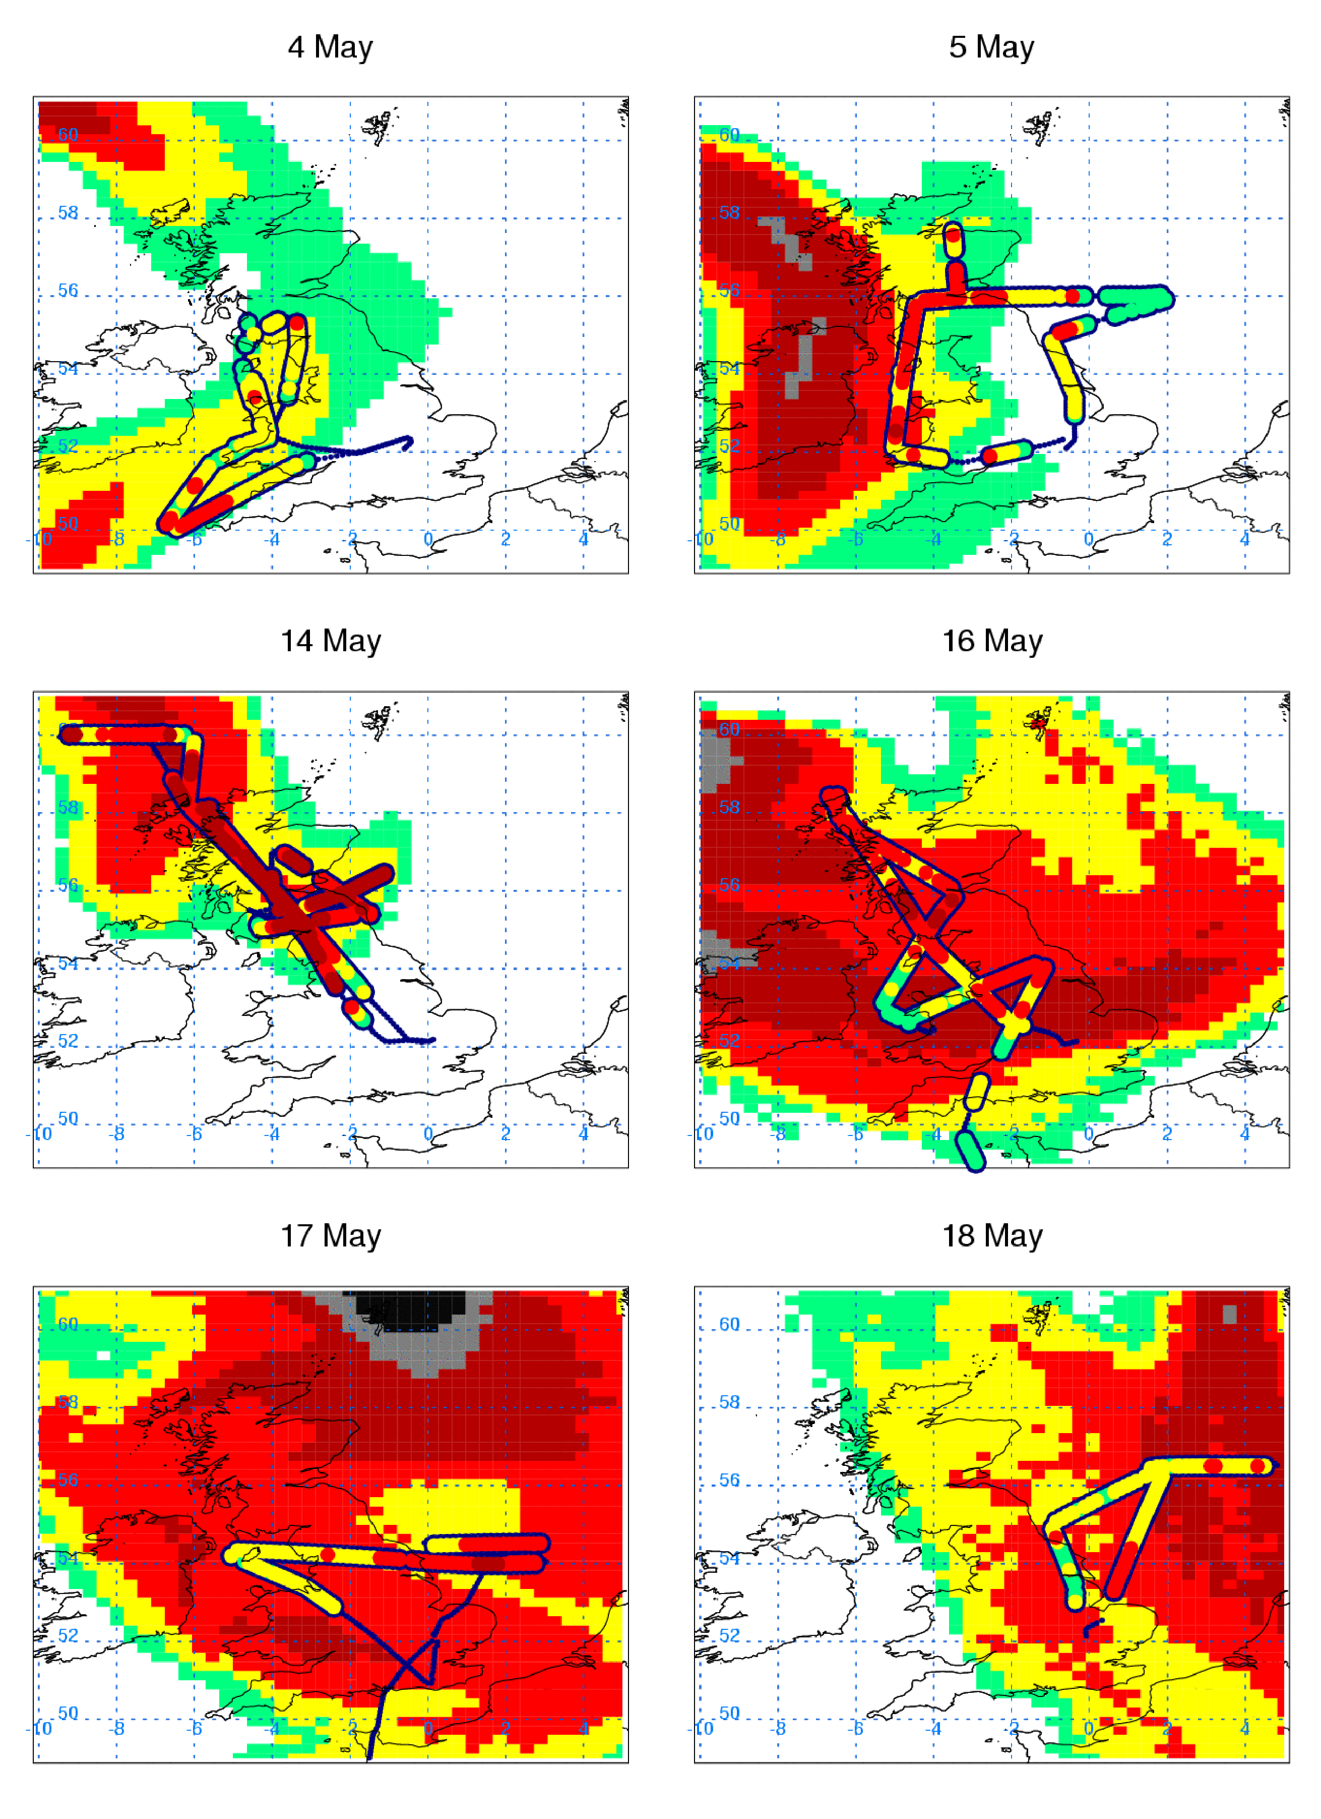
Airborne lidar vs. NAME
reasonable overall magnitude
positional errors sometimes
model uncertainties: source term, meteorology, sub-scale processes
courtesy of H. Webster
(Atmospheric Dispersion Group)

Slide 13
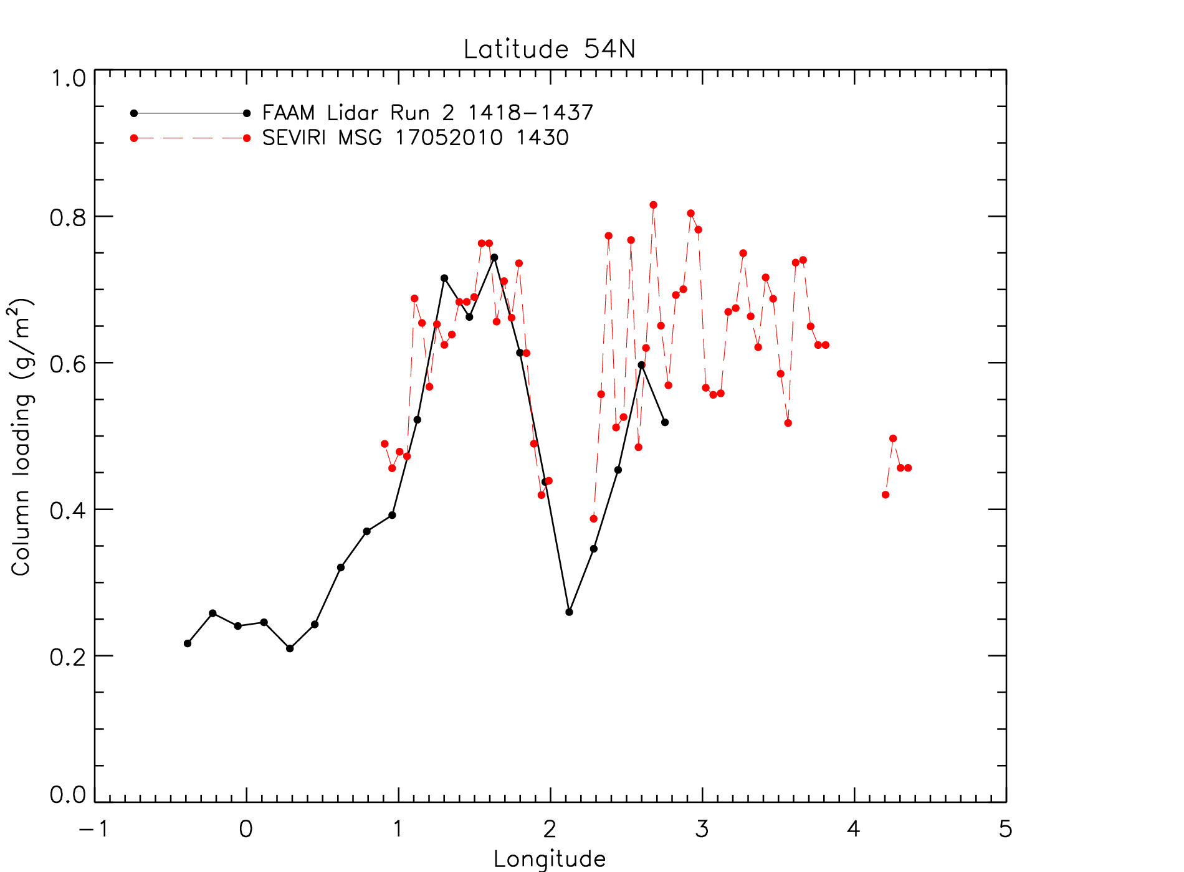
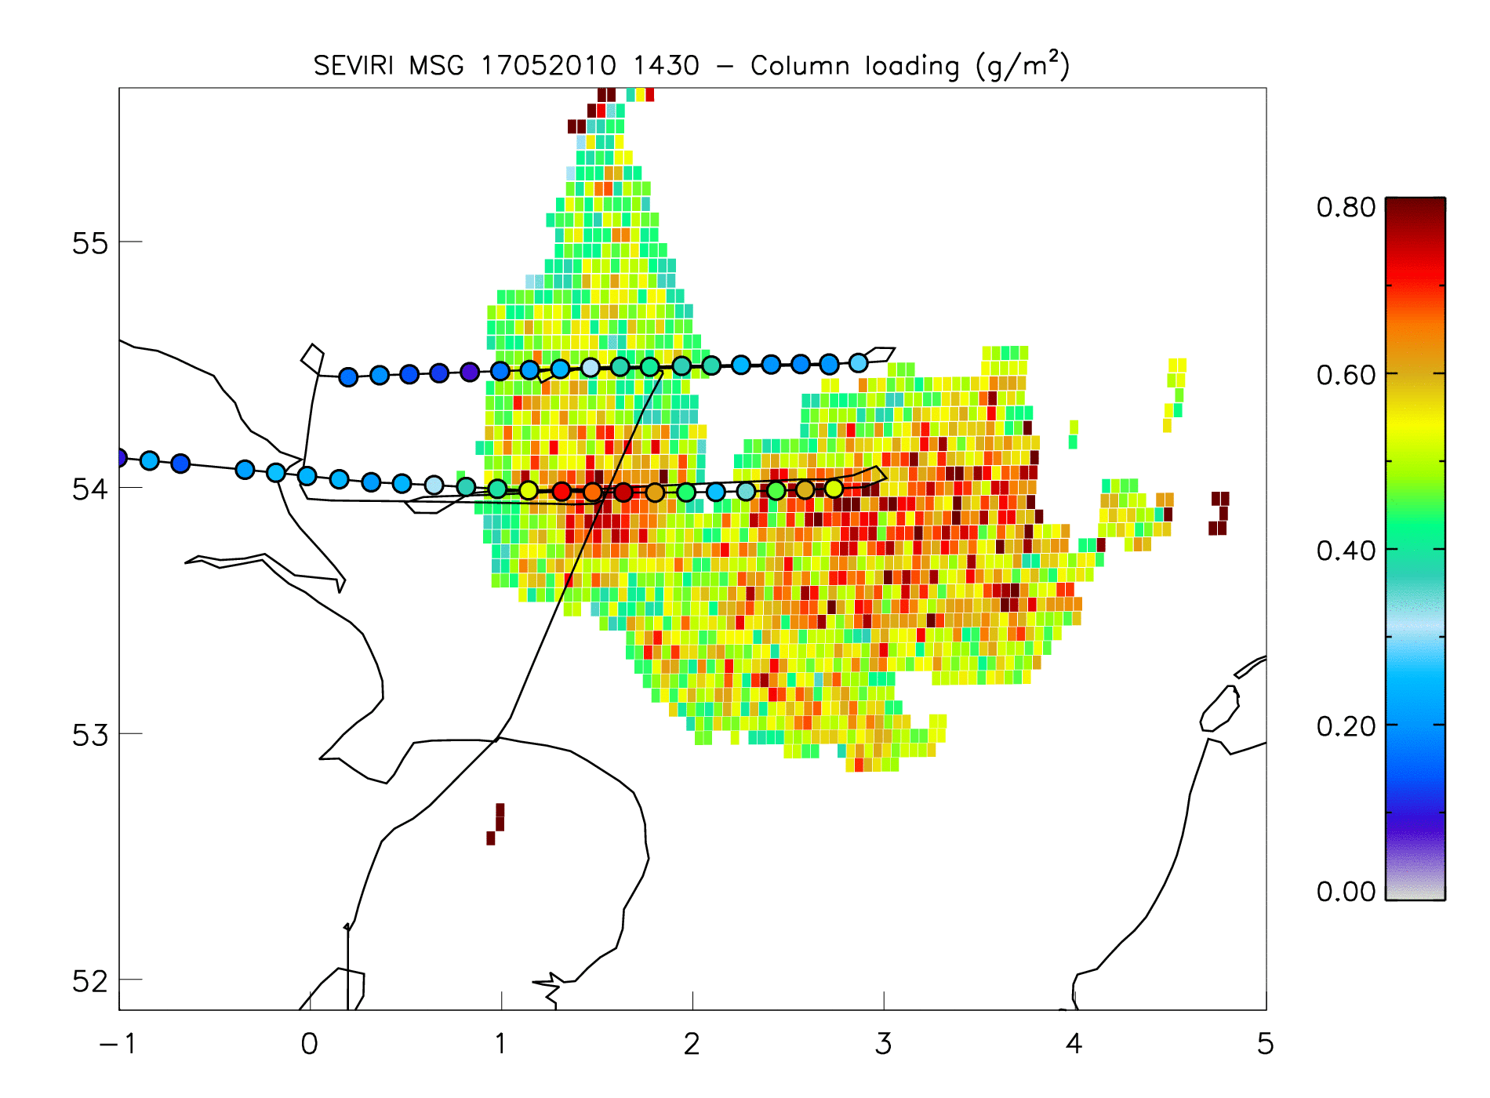
SEVIRI multichannel imager on board METEOSAT
17 May
courtesy of P. Francis and
M. Cooke (Satellite Applications)
17 May 2010

Slide 14
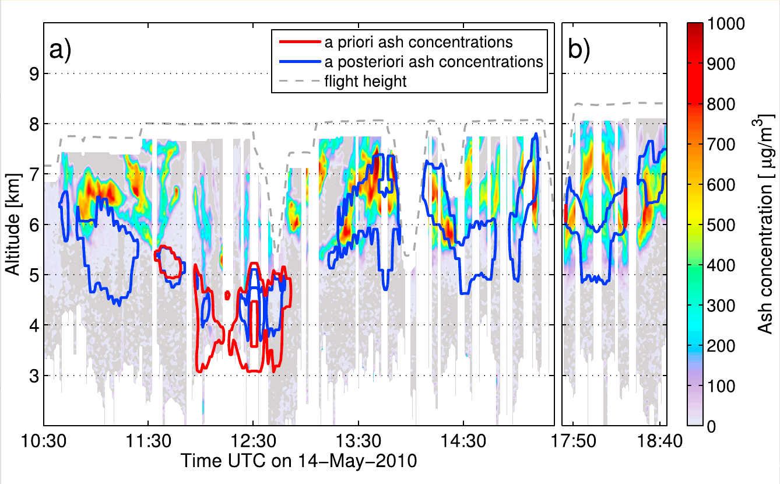
Lidar data validate model improvements using Meteosat
14 May
2010
source term: radar plume height
source term: model + SEVIRI
aircraft altitude
––– ––– : 500 mg/m³ isolines of modeled ash mass concentrations (mean of FLEXPART-ECMWF, FLEXPART-GFS and NAME-MetUM)
courtesy of N. Kristiansen (NILU, Norway)

Slide 15
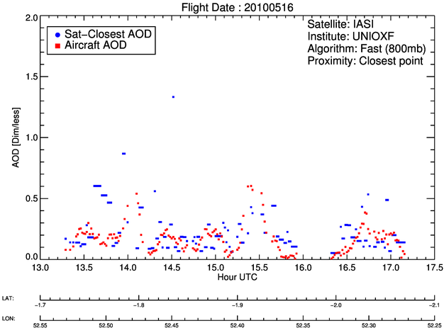
ESA study on ash retrievals (SACS-2/SMASH)
Layer AOD
Oxford IASI fast AOD (800 mbar)
courtesy of M. Koukouli (University of Thessaloniki)

Slide 16
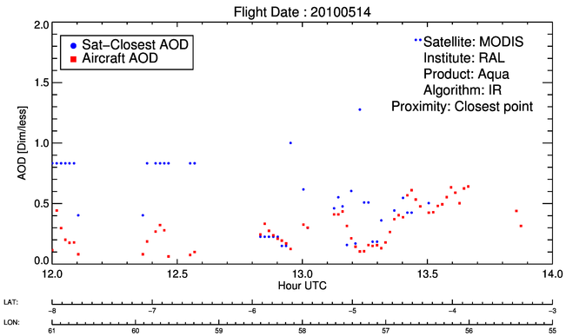
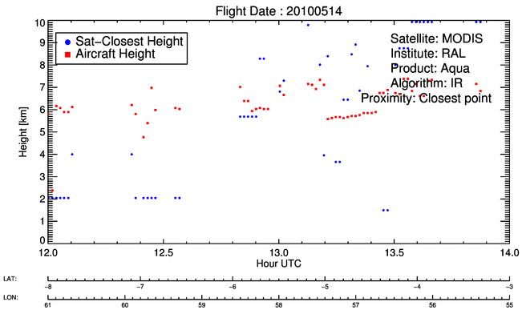
ESA study on ash retrievals (SACS-2/SMASH)
Layer AOD
RAL MODIS/Aqua IR
over land
Layer Height
courtesy of M. Koukouli
(University of Thessaloniki)

Slide 17
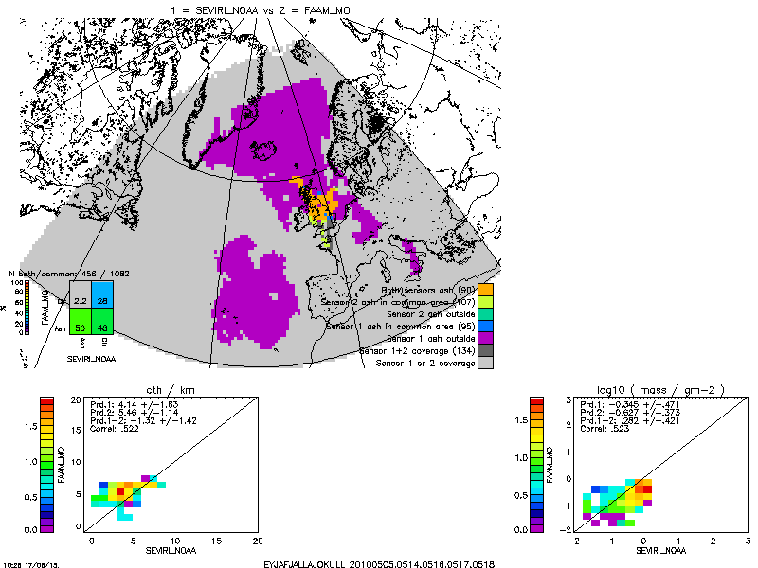
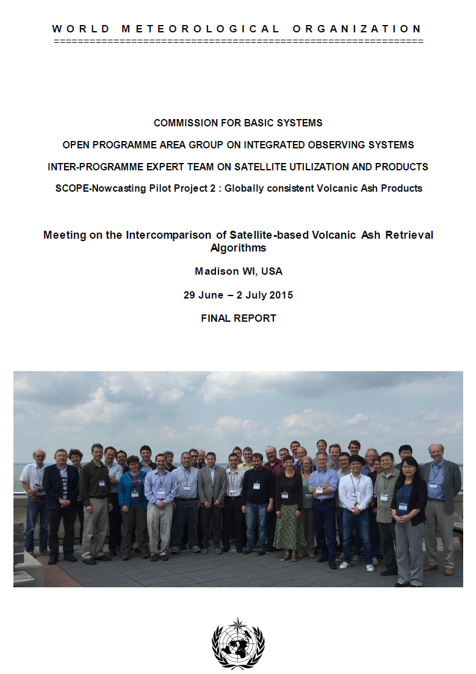
First WMO Intercomparison of Satellite-based Volcanic Ash Retrieval Algorithms Workshop
“22 algorithms from institutions and groups all over the world using passive satellite imagery were considered in the intercomparison; reference data were used from the CALIPSO CALIOP space-borne lidar instrument, the United Kingdom FAAM research aircraft, and EARLINET ground-based lidar data.”
Recomendation 10: “Provision of airborne ash measurements during future eruptions, plus resources for associated scientific analysis.”

Slide 18
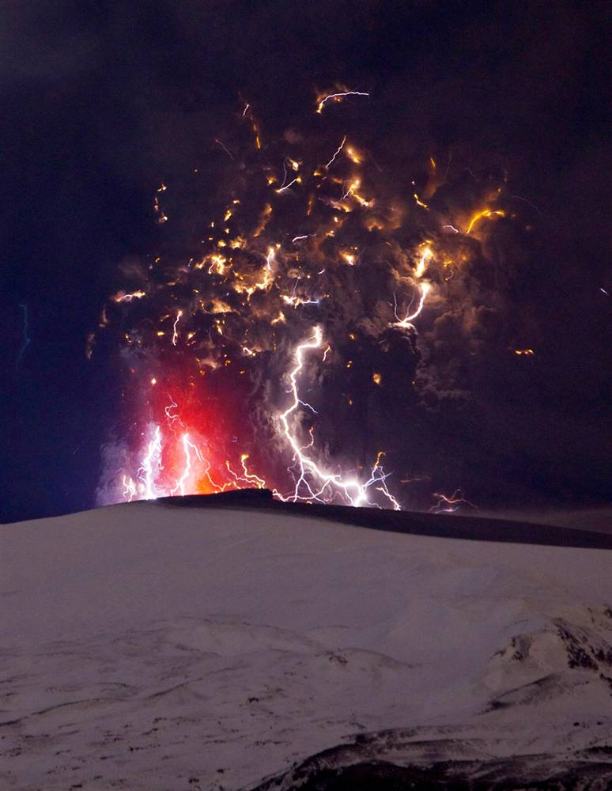
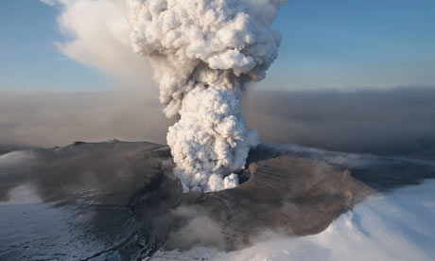
Volcanic ash: Summary
A high quality dataset established (not achieved with other means)
Ash is in patches: alt. 2–8 km; depth 1–2 km; extent 80–500 km
Extinction 0–1.2 km-1; AOD 0–0.85
Concentration 0–1900 μg/m³; Column loading 0–1.3 g/m²
Validation of remote sensing: ARIES, IASI, SEVIRI, GOME2, MODIS
Evaluation / validation of dispersion model + improvements

Slide 19
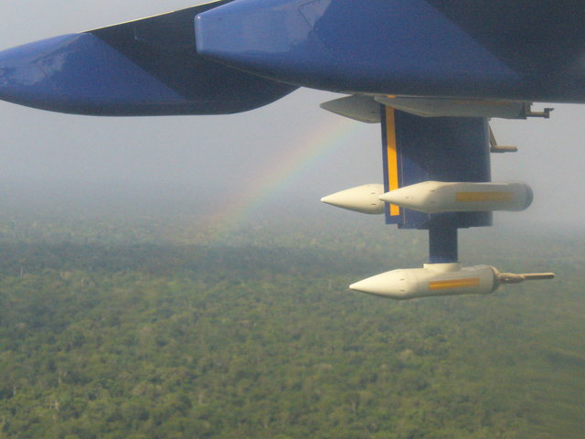
SAMBBA (2012) South American Biomass Burning Analysis

Slide 20
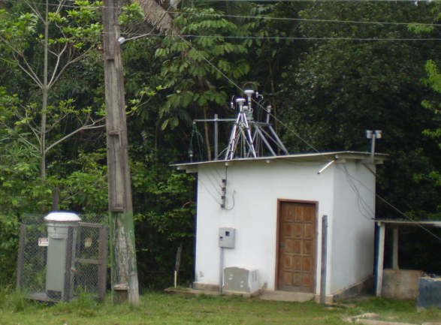
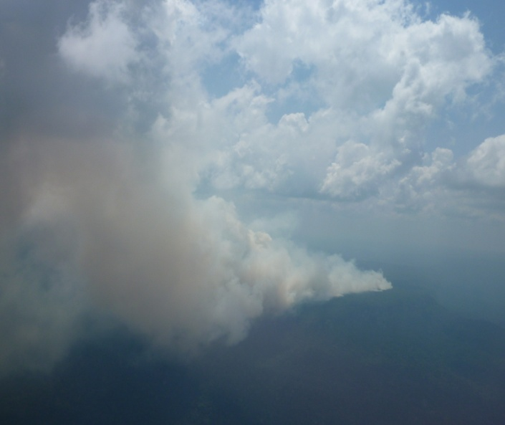
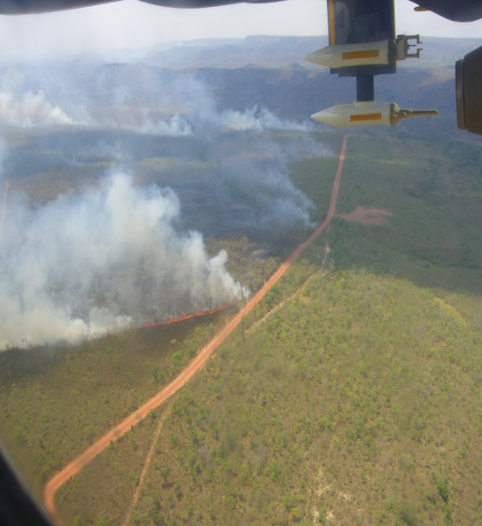
South American Biomass Burning Analysis (SAMBBA) [Brazil, Sept /Oct 2012]
20 Flights over Brazil looking at smoke from forest, savannah and cropland fires
Ground-based measurements
Atmospheric modelling studies
Satellite remote sensing of fire and smoke plumes

Slide 21
SAMBBA Broad science drivers
Quantify emissions of trace gases and aerosols from biomass burning over S. America
Changes to atmospheric composition
Impacts on climate, weather and air quality
Influence on biosphere
Evaluation of earth-system models
Validate satellite remote sensing of fires and smoke plumes
Papers are appearing in Atmos. Chem. Phys. (Special Issue)
http://www.atmos-chem-phys.net/special_issue354.html

Slide 22
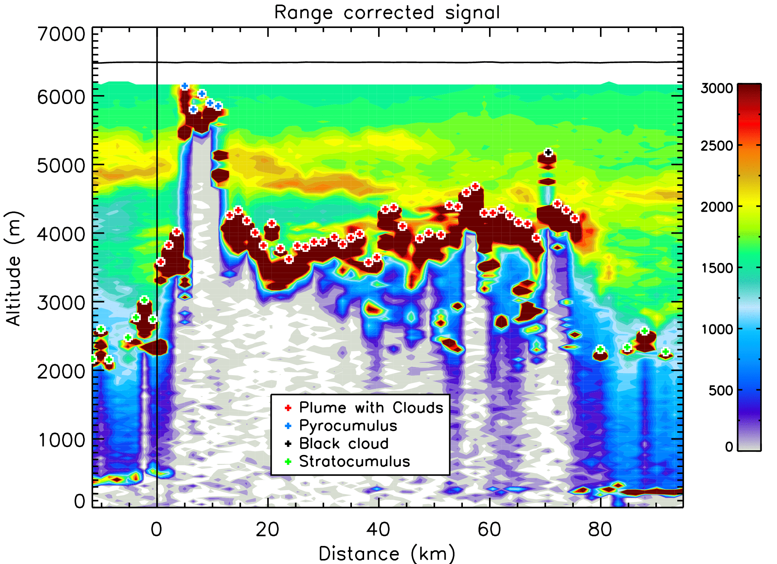
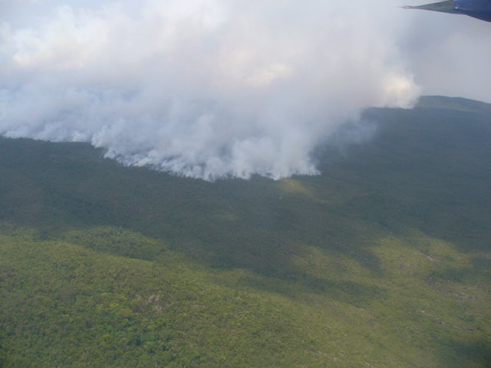
B737 – Run 18 – 17:34:26-17:43:04
B737 – Plume mapping
position of fire
→ Useful for plume rise modelling

Slide 23
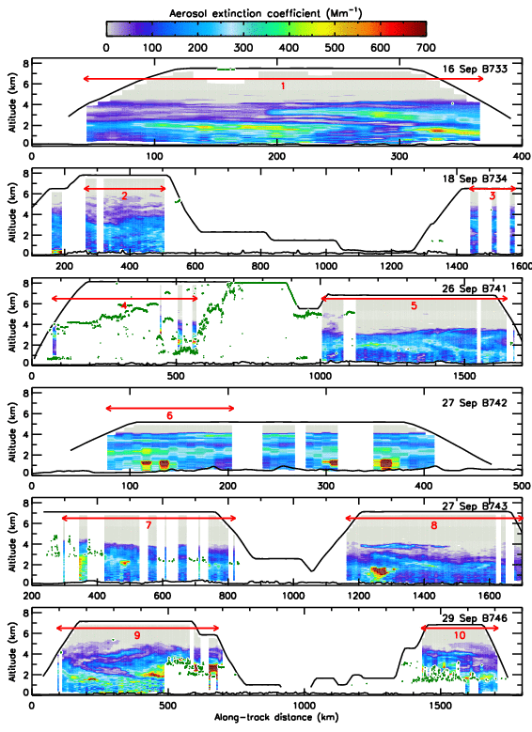
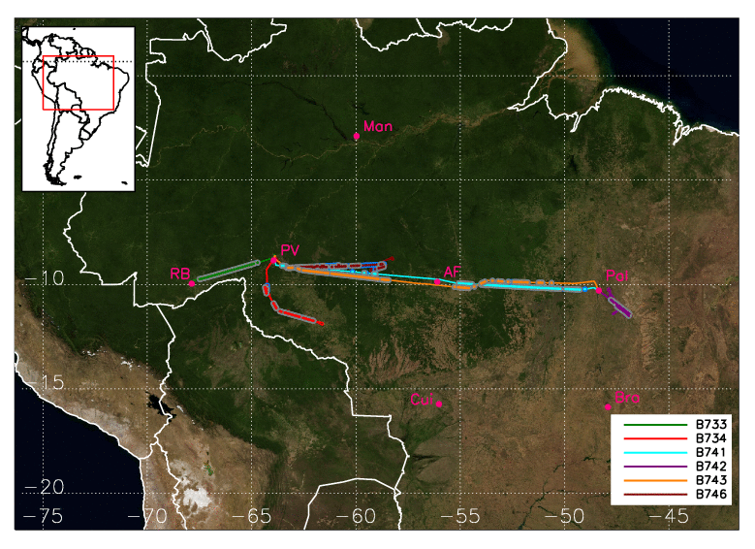
The haze of the Amazon basin
Clouds
Large extinction above
(~ 1000 Mm⁻¹)
Horizontal sections for statistical analysis
Single fire plumes ( ~ 1000 Mm⁻¹ )
Elevated layer, AOD 0.09
200-400 m deep
Horizontal extent 270 km

Slide 24
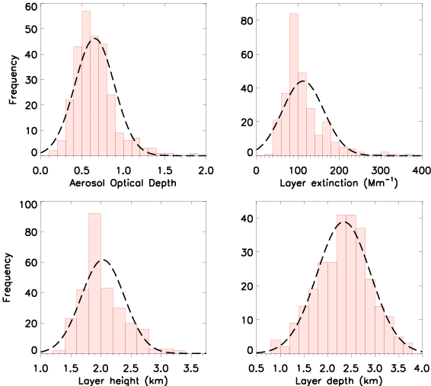
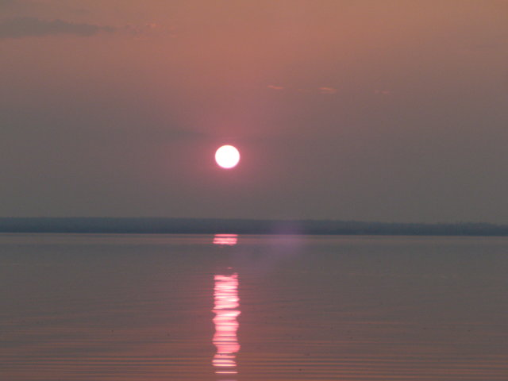
Statistical analysis
Quantitative properties:
Variability ~40%
Geometrical properties:
Limited variability (~20%)
over ~ 2200 km and 14 d

Slide 25
Models used in comparison
MetUM:
LAM configuration (Amazonia domain – set up for flight planning)
12 km resolution
70 levels
Lateral boundary conditions from UM Global Model
CLASSIC aerosols scheme – first attempt at using this in NWP
Direct aerosol effects included (scattering+absorption)
Emissions: GFAS X 1.7
Injection height: 0-3 km (prescribed)
ECMWF-MACC:
Operational global composition model
~ 80 km resolution (T255)
60 levels
5 aerosols species
MODIS AOD assimilated in 4D-VAR
Emissions: GFAS X 3.4
Injection height: Surface, GFAS PRM (experimental)

Slide 26
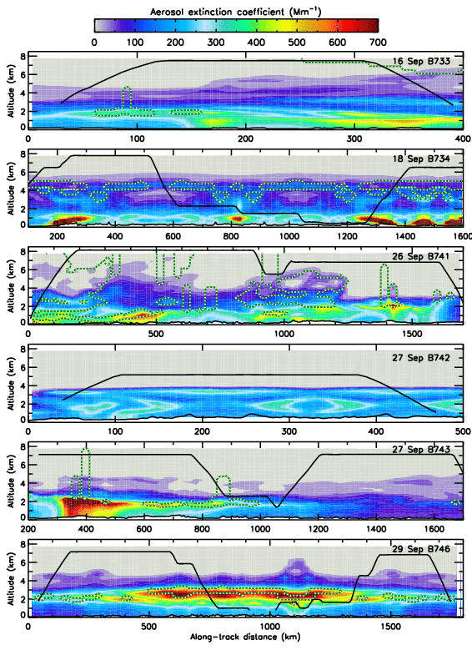
Comparison to MetUM (LAM)
Emissions at 0–3km
courtesy of Jane Mulcahy and Ben Johnson

Slide 27
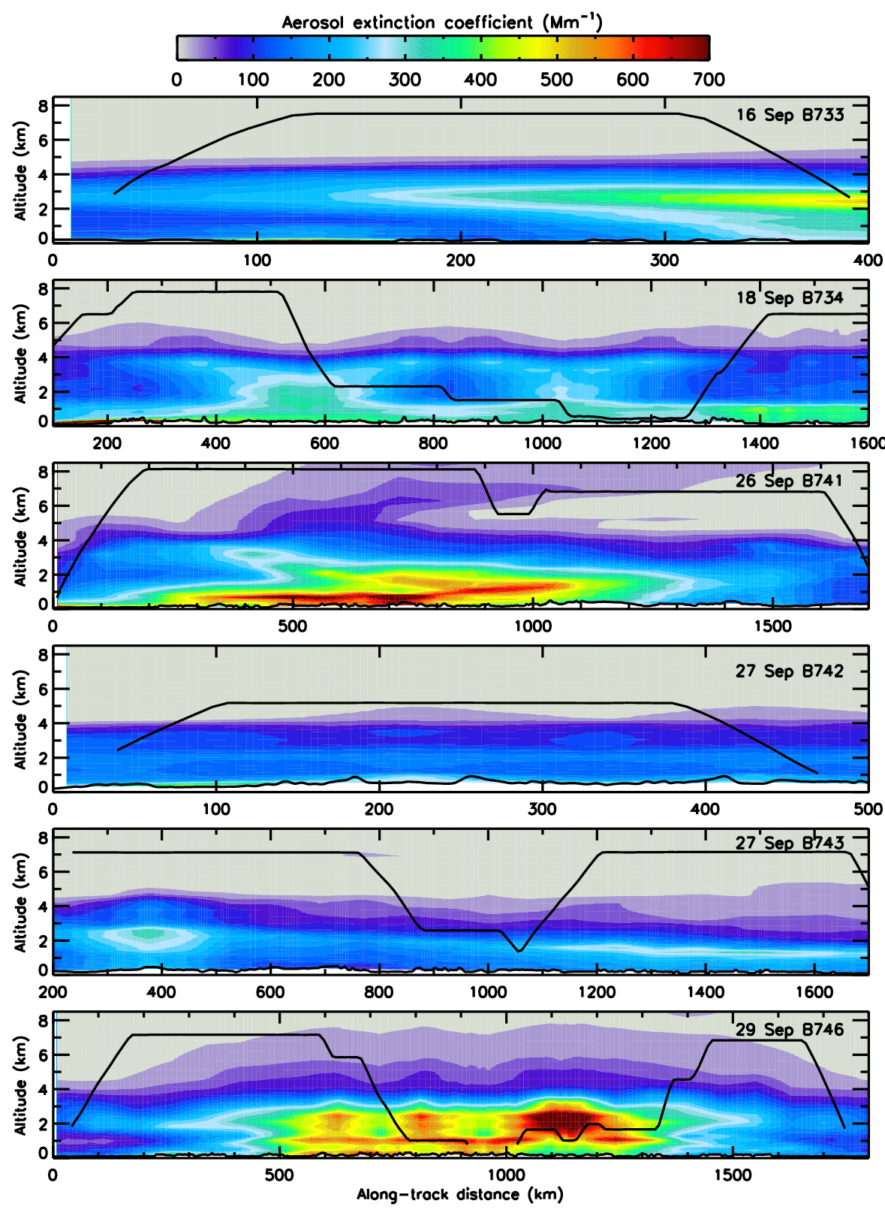
Comparison to ECMWF-MACC (Global)
Emissions at surface
courtesy of Samuel Remy, Angela Benedetti, and Luke Jones

Slide 28
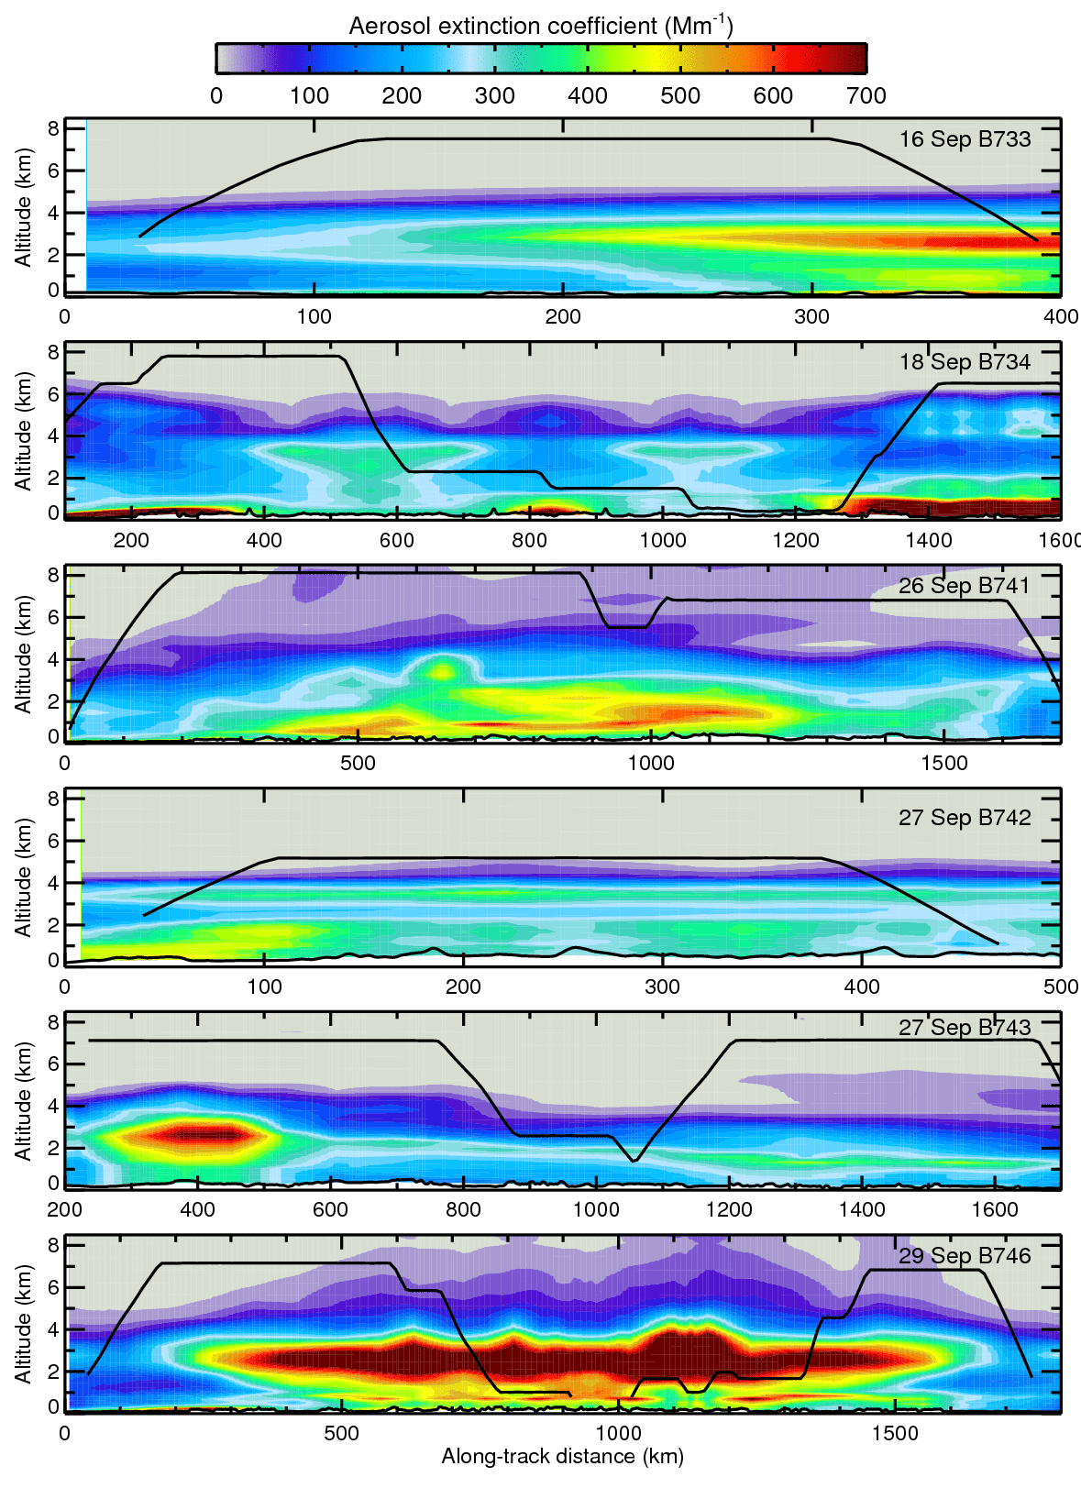
Comparison to ECMWF-MACC (Global)
higher AOD
Emissions at max. injection from PRM
double layer
courtesy of Samuel Remy, Angela Benedetti, and Luke Jones

Slide 29
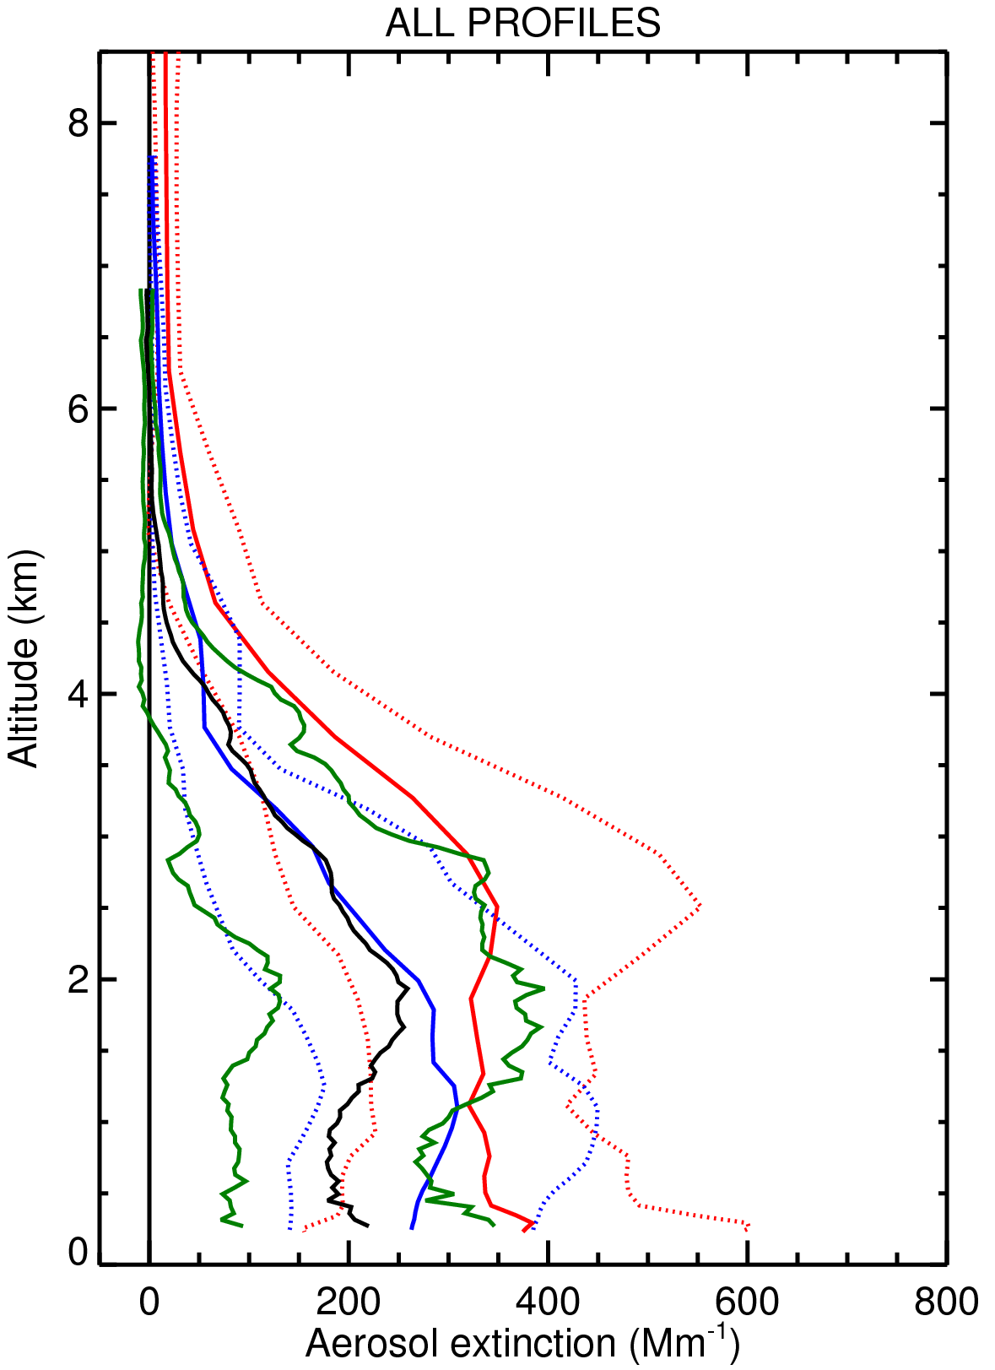
Comparison to MetUM and ECMWF-MACC
–––– Lidar average
–––– Lidar std. dev.
–––– MetUM
–––– ECMWF-MACC

Slide 30
SAMBBA: Summary
AOD 0.65 ± 0.24
Structure relatively consistent over 2200 km/14 d
Consistency with Baars et al. (2012), Huang et al. (2015), and Bourgeois et al. (2015)
Model representation is realistic (except single plumes)
ECMWF-MACC: slight overestimation of the AOD
MetUM CLASSIC: has skill for BB aerosol prediction
ECMWF-MACC: PRM injection heights assessed vs. Surface emissions
Baars et al, J. Geophys. Res. 117, D21201,doi:10.1029/2012JD018338, 2012.
Bourgeois et al, J. Geophys. Res. 120, 8411–8425, 2015.
Huang et al, J. Geophys. Res. 120, 5085–5100, 2015.

Slide 31
SAMBBA CALIPSO underpass
Broken clouds at boundary layer top
Elevated smoke layer
AOD 0.03, 600 m deep
Smoke in boundary layer
Extinction ~ 110 Mm⁻¹, 2200 m deep
Elevated layer not detected
Gaps in boundary layer
Polluted dust subtype incorrectly detected due to incomplete removal of cloud signal, and hence spurious depolarisation
Note: low level clouds cause high albedo and hence large solar background.

Slide 32
SAMBBA CALIPSO underpass

Slide 33
SAMBBA CALIPSO underpass
Difficult conditions for CALIPSO: daytime and broken clouds
Good mean profile, but with some weaknesses
highlighted in the detailed representation
Thin elevated layer missed
Gaps in the BL aerosol (~ 30%)
Oscillating aerosol subtype (Smoke / Polluted Dust)
Incorrect removal of cloud signal → Polluted Dust
Similar “mean” profile

Slide 34
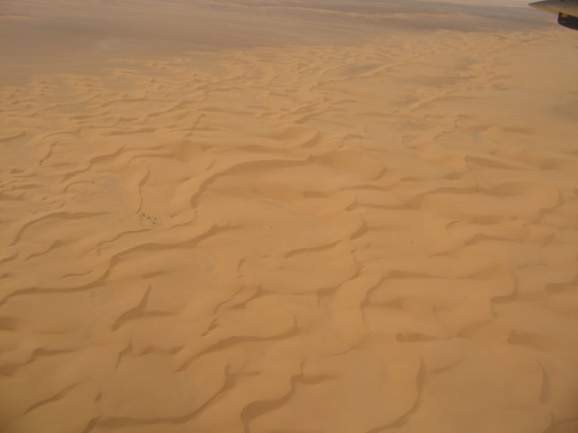
Fennec (2011+2012) The Saharan Climate System

Slide 35
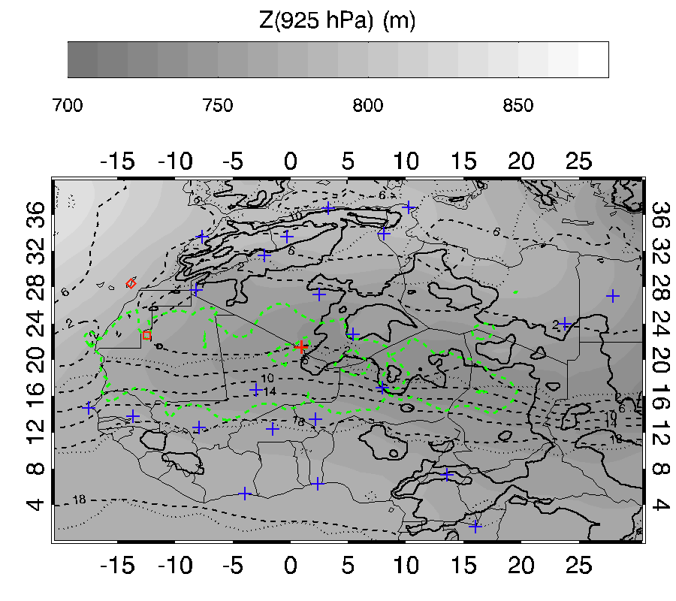
The Fennec campaign on Saharan meteorology
June 2011 mean state
The Saharan Heat Low (SHL) is a key driver of the West African Monsoon (Lavaysse et al., 2009)
Fennec provided the most comprehensive dataset for the SHL to date.
Energy budget of SHL depends on radiative balance (includes clouds) and ventilation.
Saharan dust is also an effective ice nucleus
(Marsham et al., 2013)
SS1
SS2
OMI dust
ITD limits
+ Operational radiosounding

Slide 36
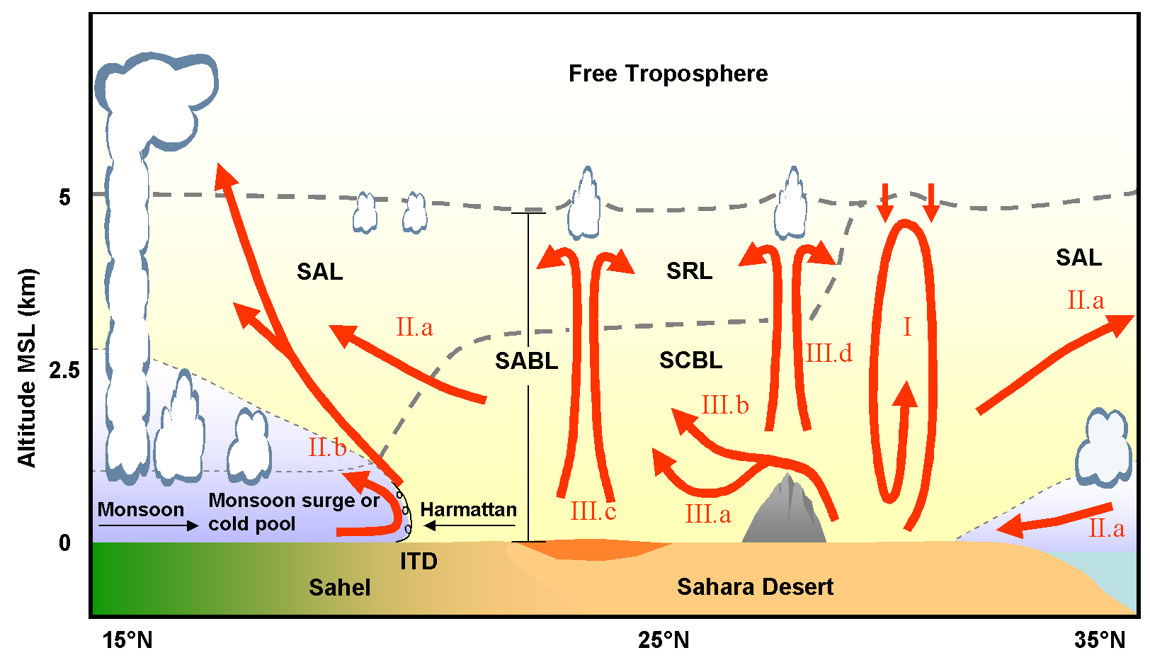
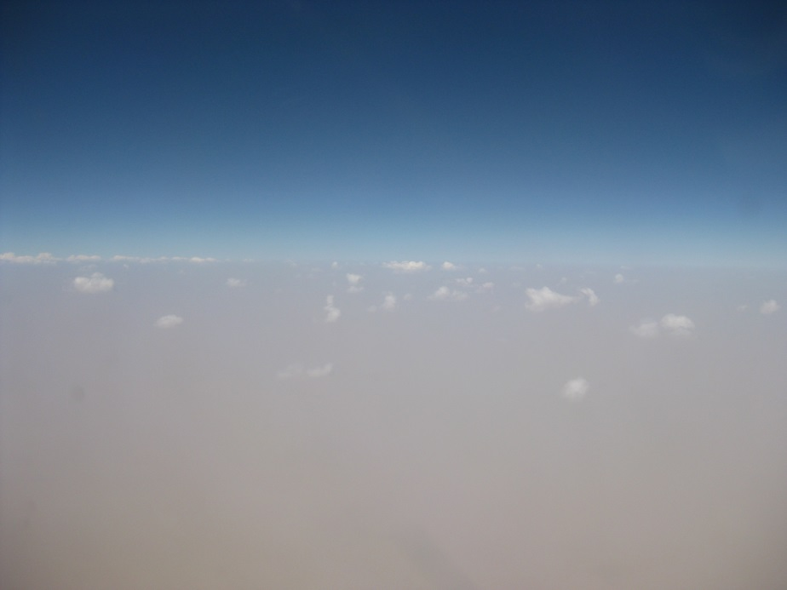
Clouds in the Sahara – Fennec
(Cuesta et al., 2009)
Boundary layer is very dry, but so deep (~5km) that clouds routinely form at its top, fed by dry dusty air.
The Sahara is surprisingly cloudy
Small clouds above dusty desert provide a challenge for remote sensing and models.
Fennec provides airborne surveys of cloud cover at high spatial resolution
Evaluate models and remote sensing (e.g. METEOSAT)

Slide 37
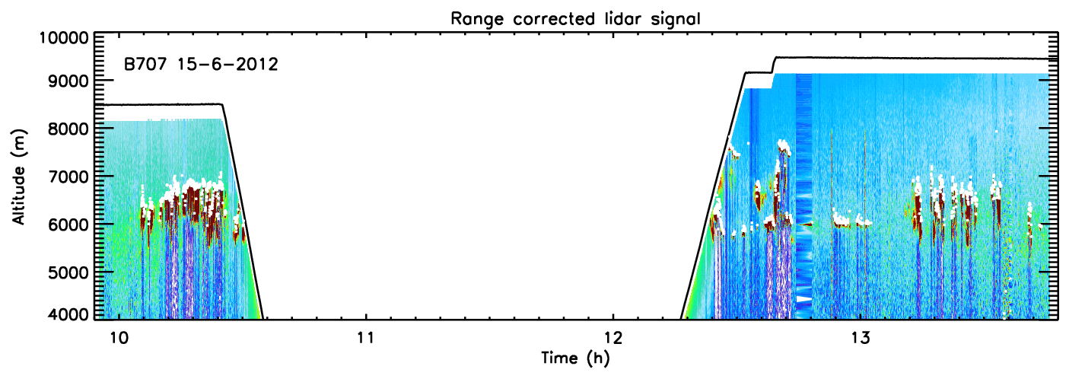
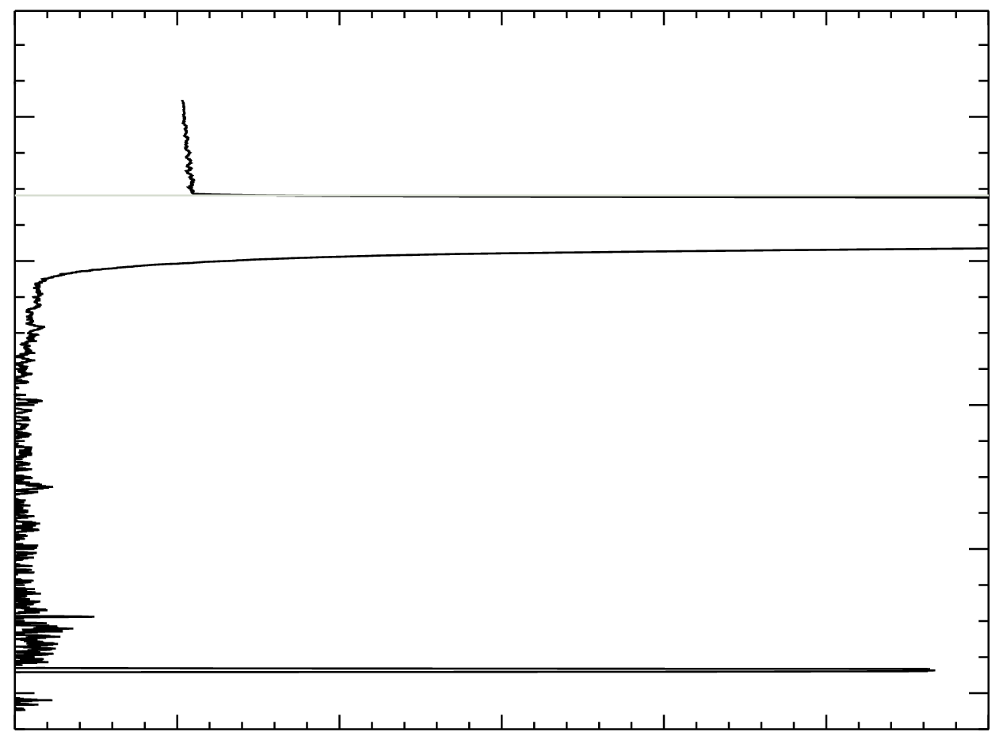
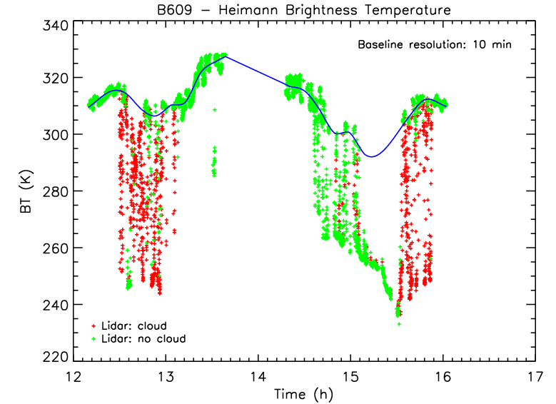
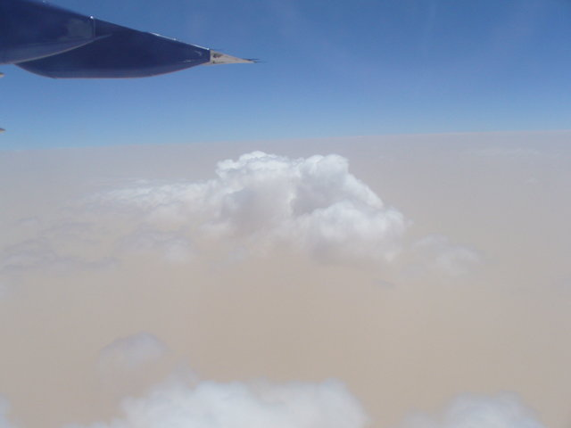
Lidar + Heimann: cloud detection
detected cloud
tops in white
baseline (surface)
λ ~ 8 –12 μm
not always
above cloud
cold: cloud
Lidar is necessary to determine the
baseline to use with the Heimann

Slide 38
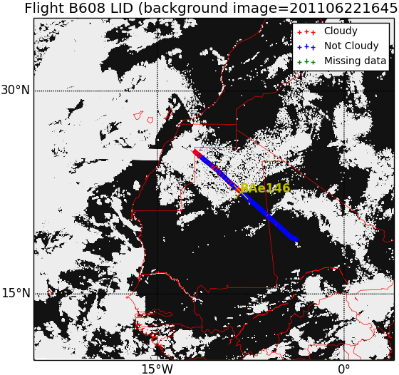
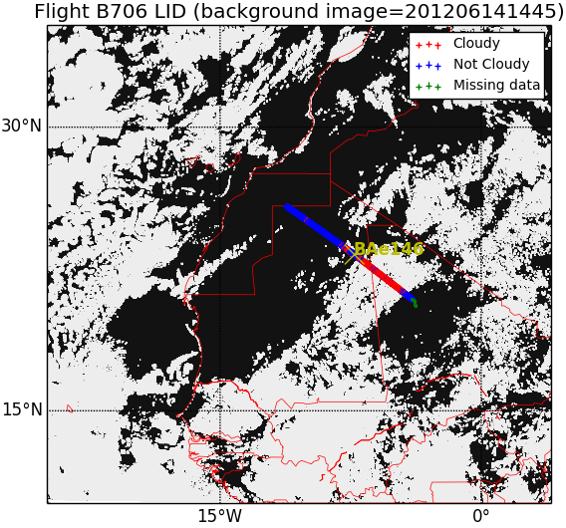
Verify SEVIRI cloud detection
courtesy of John Kealy

Slide 39
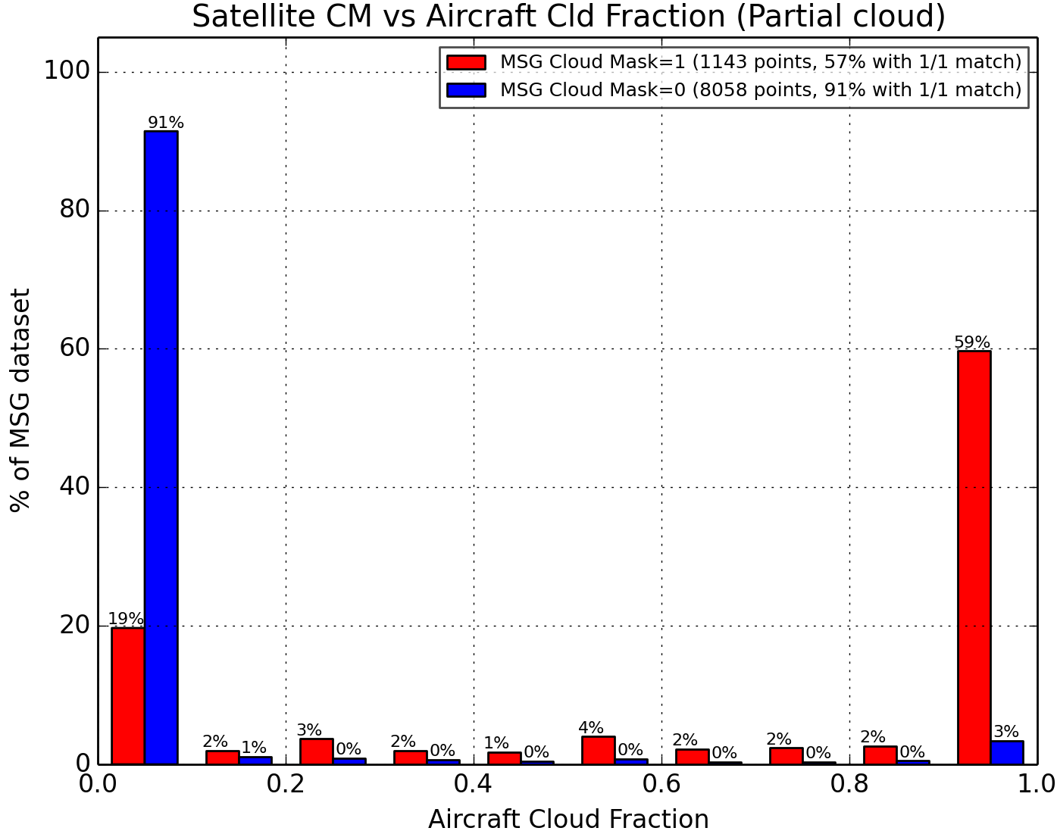
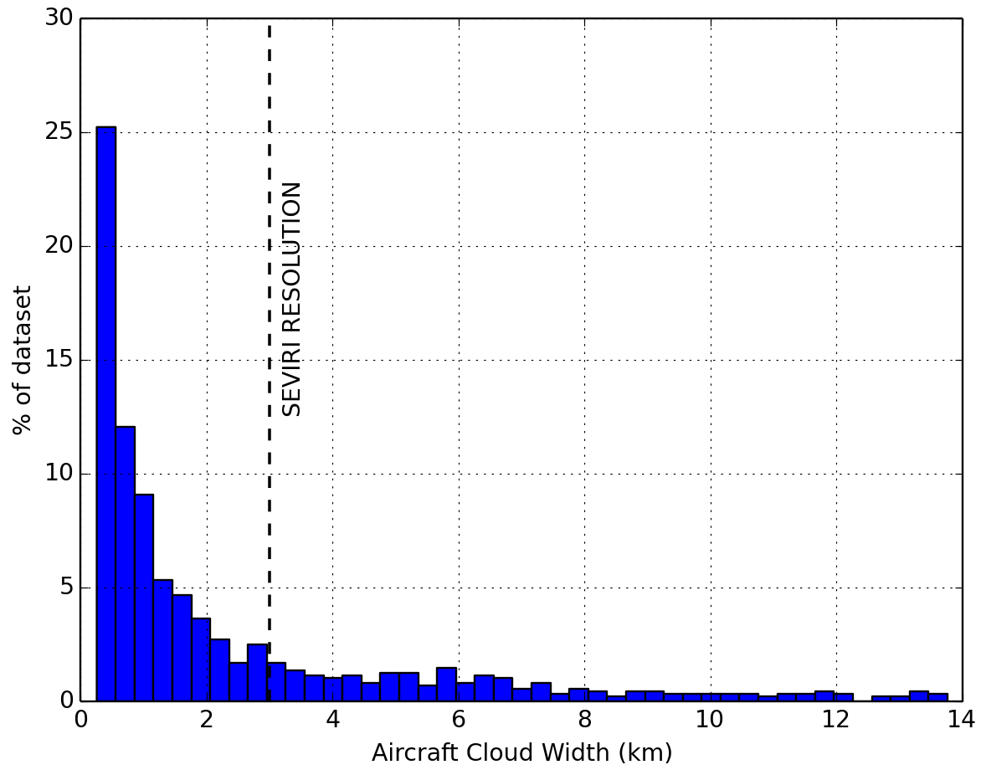
Verify SEVIRI cloud detection
courtesy of John Kealy

Slide 40
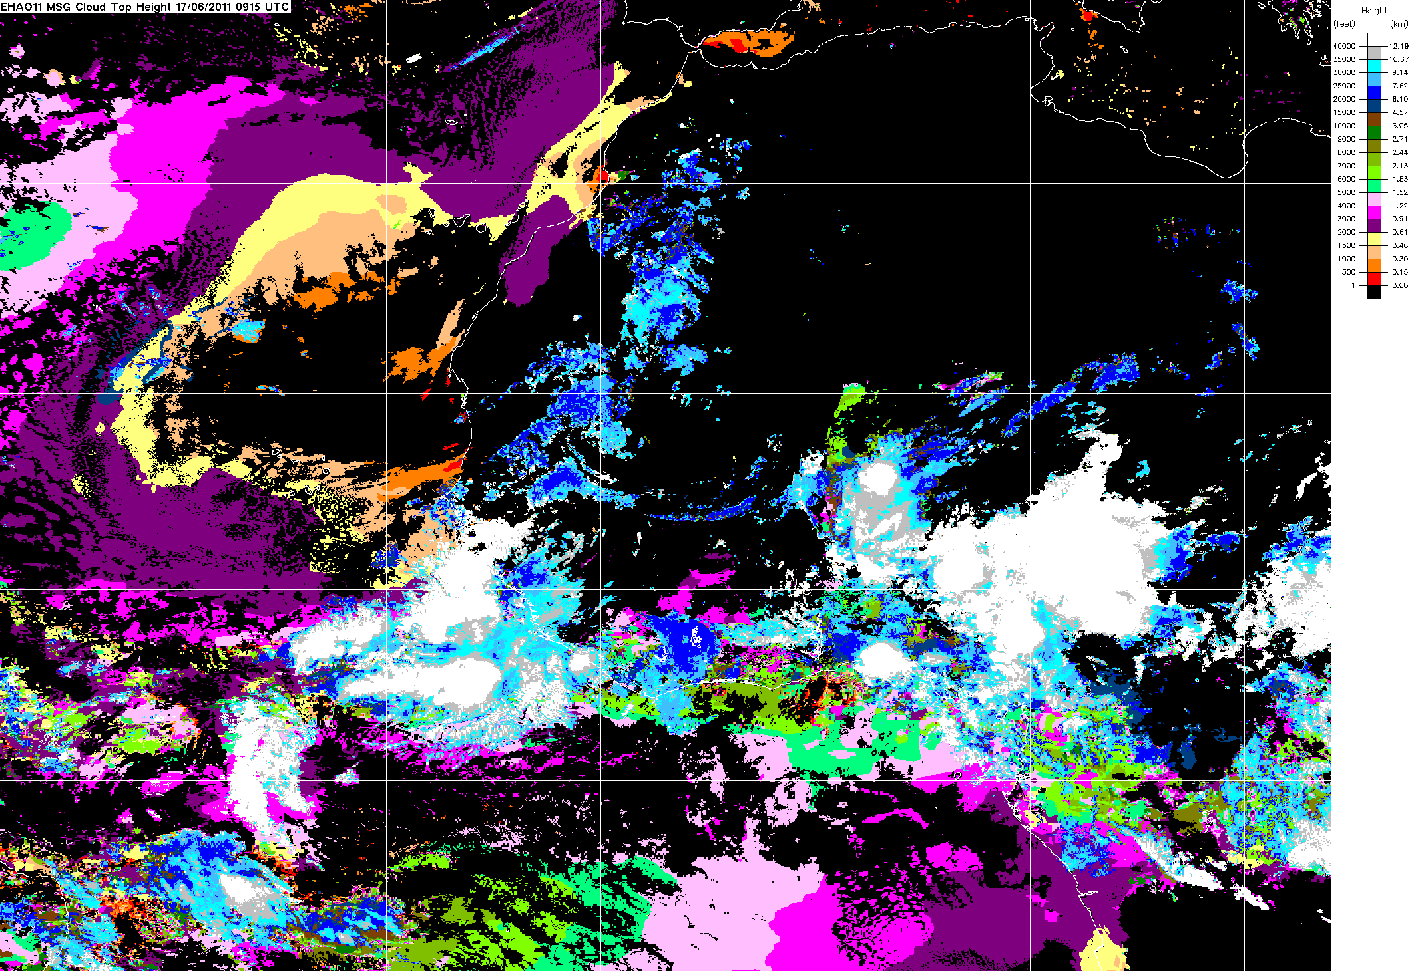
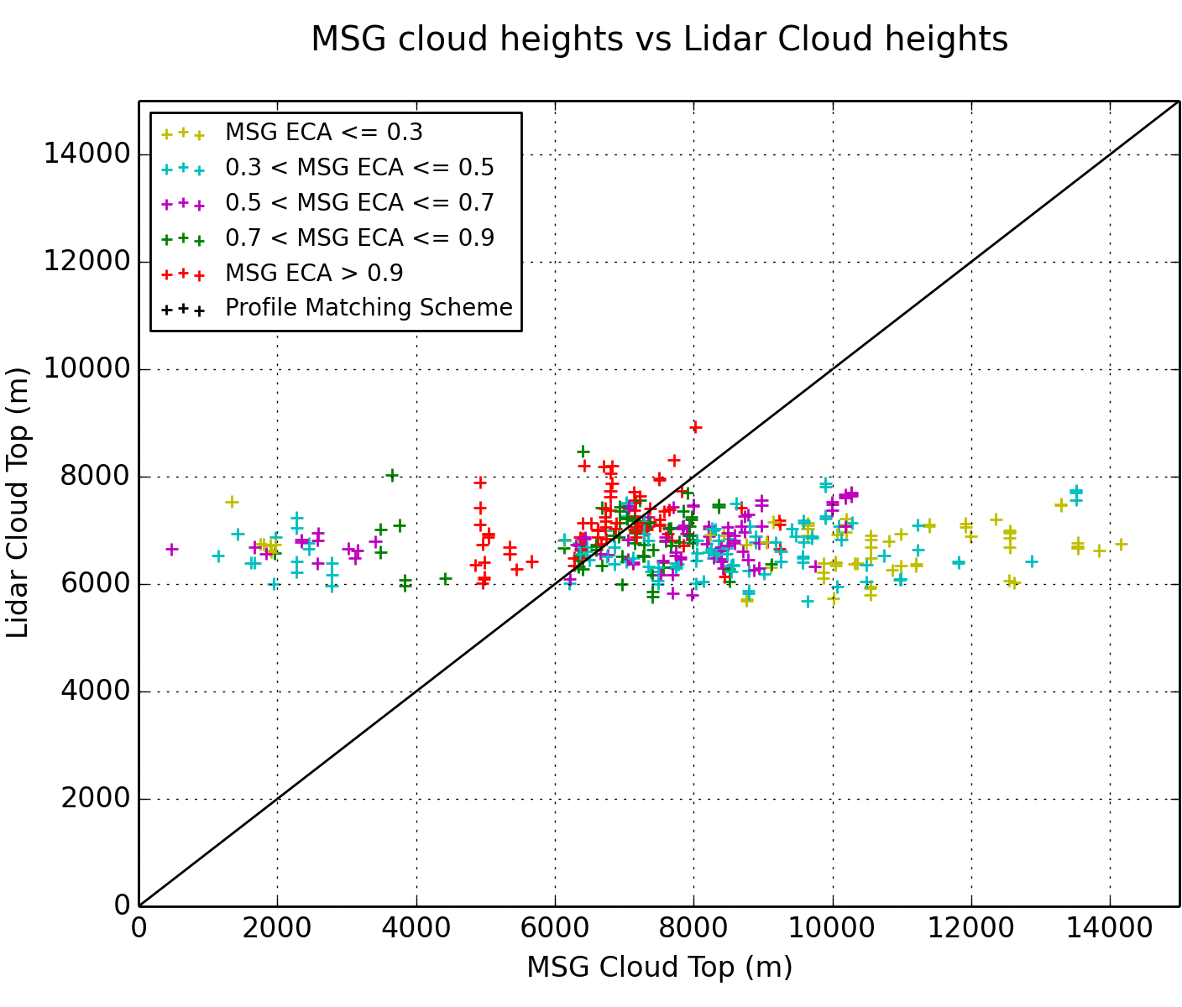
Verify SEVIRI cloud top height
courtesy of John Kealy

Slide 41
Clouds in the Sahara: Summary
Generally good cloud mask, with a slight overall overestimation of cloudiness in SEVIRI
Underestimate of cloud top height found with the ‘profile matching scheme’
Overestimates of cloud top height with the ‘minimum residual scheme’
Estimate of cloud top height linked with estimate of effective cloud amount (ECA)
Work is still in progress...
courtesy of John Kealy

Slide 42
Lidar for cloud studies

Slide 43
Verification of cirrus scattering model
Courtesy of A. Baran

Slide 44
Stratocumulus top height
Courtesy of S. Osborne and S. Abel

Slide 45
ICE-D / AER-D / SAVEX-D Cape Verde, August 2015

Slide 46
ICE-D / AER-D / SAVEX-D
ICE-D: dust-cloud interactions and subsequent evolution of towering cumulus clouds (role of dust as IN) – 10 successful flights
AER-D mapping: validate 1D-VAR dust retrievals from MSG SEVIRI (for future use in data assimilation) + potential modelling studies – 2 successful flights (1 is a double)
AER-D space lidar: validate the retrievals of the space lidar CATS on the ISS – 1 successful flight (Note: 2nd flight CATS not working!)
SAVEX-D: validation of AERONET/SKYNET sunphotometer measurements of dust properties (size distribution, optical properties) – 2 successful flights
Additional objective: validation of U. Hertsfordshire’s dust sondes – 5 sondes (2 sondes coincident with a/c)

Slide 47
Ground Obs
University of Leeds/NCAS
Dual-polarisation X-band radar
University of Manchester
Aerosol container
U.Valencia/Met Office
Sunphotometers
AERONET Cimel
SKYNET Prede
University of Hertfordshire
Dustsondes

Slide 48
ICE-D / AER-D / SAVEX-D
First data
Aircraft PSD
(courtesy of Claire Ryder):
Airborne lidar
AERONET PSD (SAVEX-D):
UM dust predictions
Nephelometer

Slide 49
ICE-D / AER-D / SAVEX-D
B923 mapping flight
courtesy of Debbie O’Sullivan

Slide 50
CATS underflight
Airborne lidar “relative depolarisation”
courtesy of
Vassilis Amiridis
CATS Feature Type
CATS Extinction coefficient 1064 nm

Slide 51
B710: sun-photometer validation (SAVEX)
This example
is from the FENNEC campaign
courtesy of V. Estelles (U. Valencia, Spain) and C. Ryder (U. Reading)

Slide 52
Some future campaigns
SWAAMI (India, Spring 2016): aerosols and Indian monsoon
CLARIFY (Namibia, Autumn 2016): BB aerosol and Sc
Space lidar cal/val: ADM-Aeolus proposal (when launched)

Slide 53
Meteorological Research Flight
Has a long history (70 years) and is admired internationally
Major asset to the Met Office and the UK academic community
Provides independent observations of atmospheric fields
Permits to complement observations from several instruments
Provides insight useful for modelling, remote sensing, and processes/parametrizations

Slide 54
BAe-146 airborne lidar
A short but successful history (6 years)
Very useful in the handling of the volcanic ash emergency
Aerosol quantitative 2-D mapping: permits the verification and validation of modelling and satellite application products
Has been useful in the characterization of cloud processes and cloud detection
Has had a direct impact on Met Office products

Slide 55
Acknowledgements: Airborne data was obtained using the BAe-146-301 Atmospheric Research Aircraft flown by Directflight Ltd and managed by the Facility for Airborne Atmospheric Measurements (FAAM), which is a joint entity of the Natural Environment Research Council (NERC) and the Met Office. Thanks to all colleagues who provided data and plots (named on slides).

Slide 56
Questions?
Alan Vance

