Slide 1
Lidar Technique: Basic Hardware Components (Lasers and Electronics)
Prof. Dr. Alex Papayannis
Head of the Laser Remote Sensing Unit (LRSU)
National Technical University of Athens, Greece
Website: http://lrsu.physics.ntua.gr/en
Email: apdlidar@central.ntua.gr

Slide 2
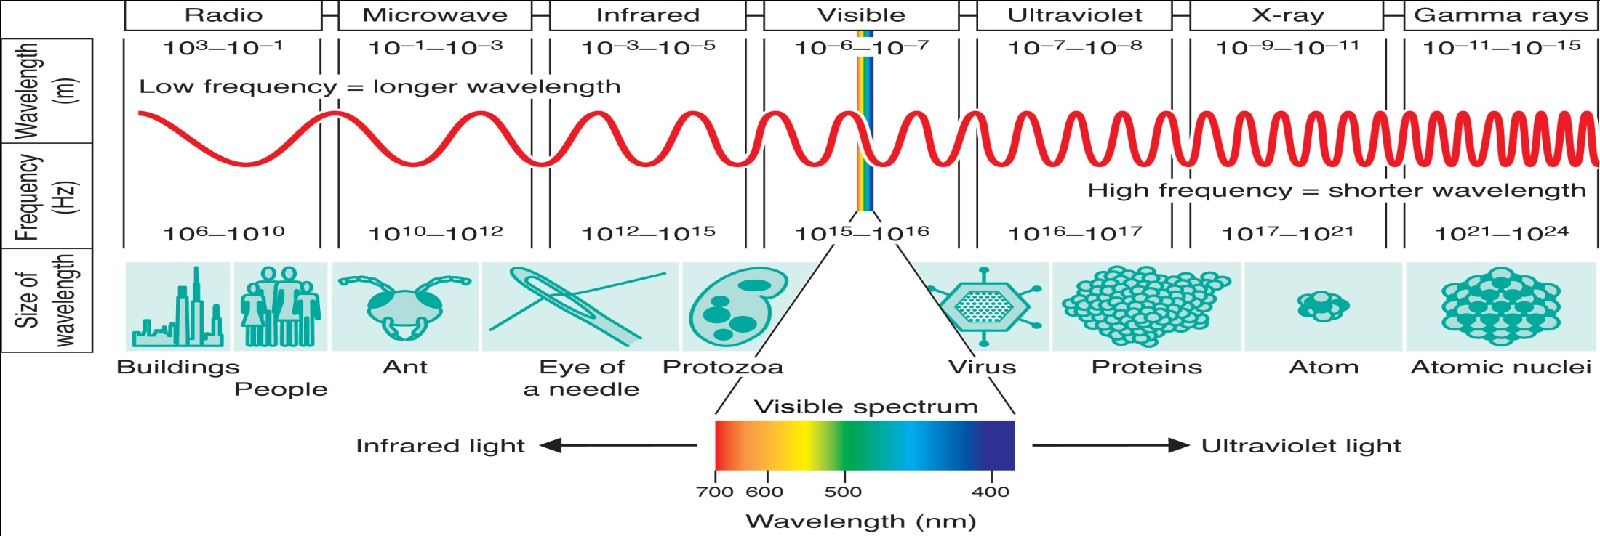
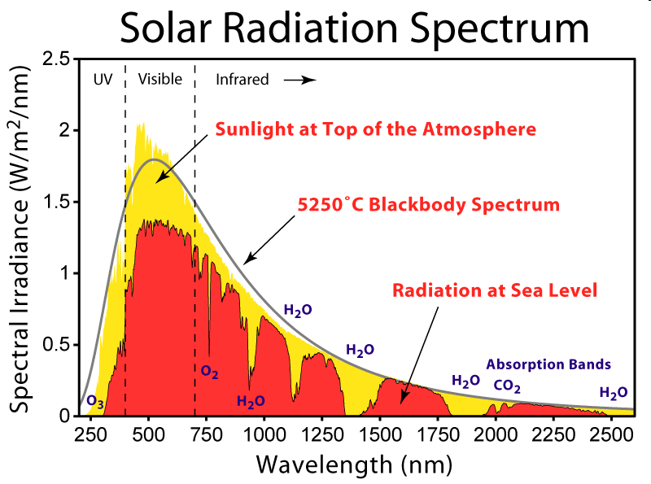

Slide 3
Lidars: from around 260 nm → several microns

Slide 4
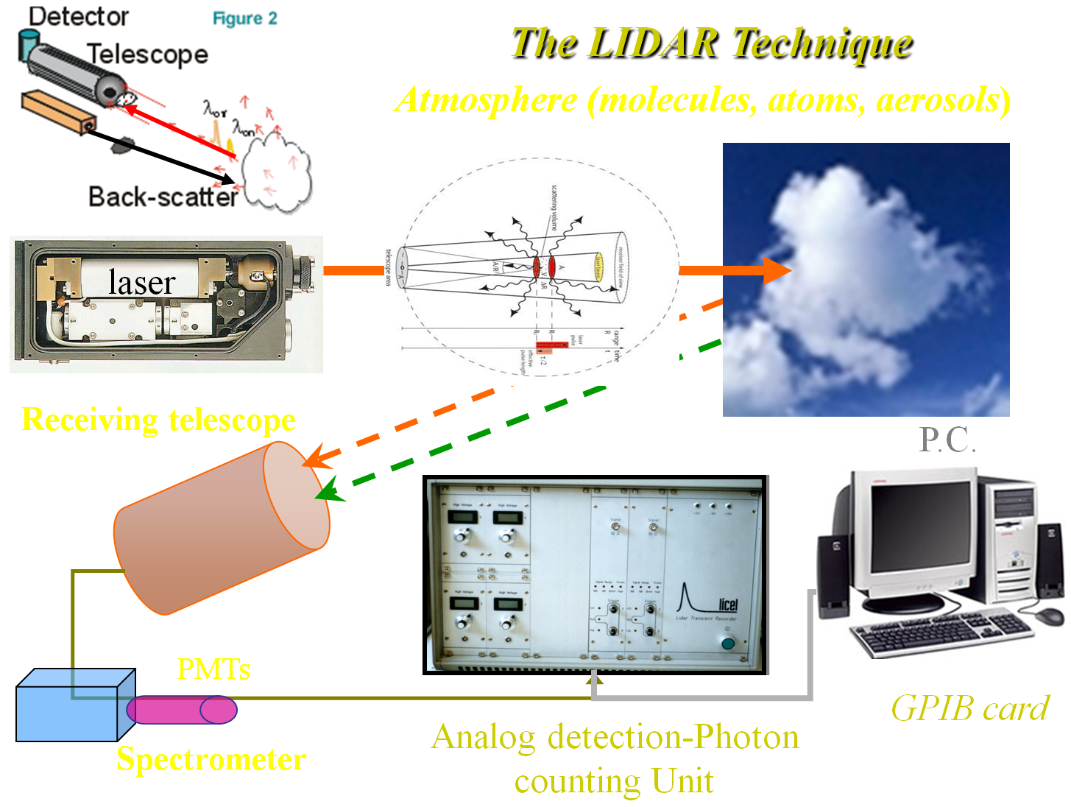


Slide 5
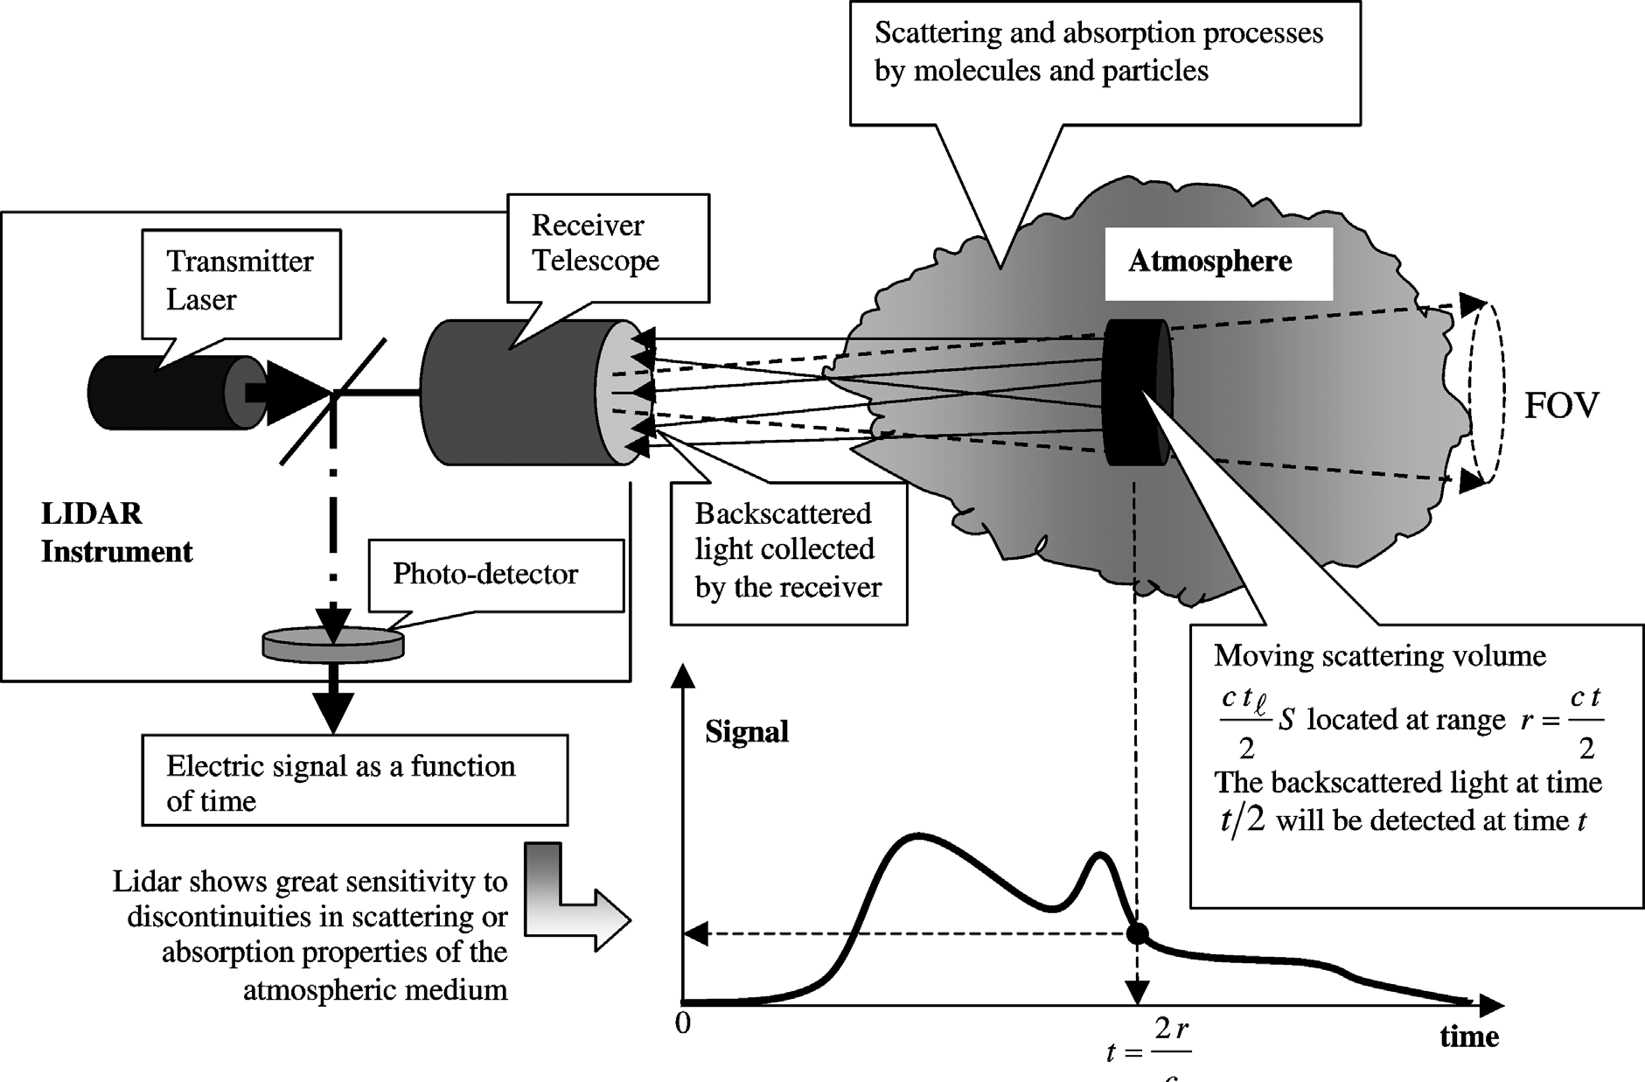
Typical LIDAR Experimental Set-up
c

Slide 6
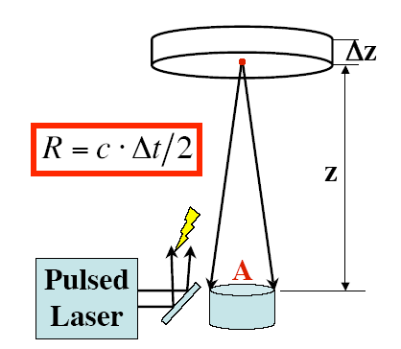
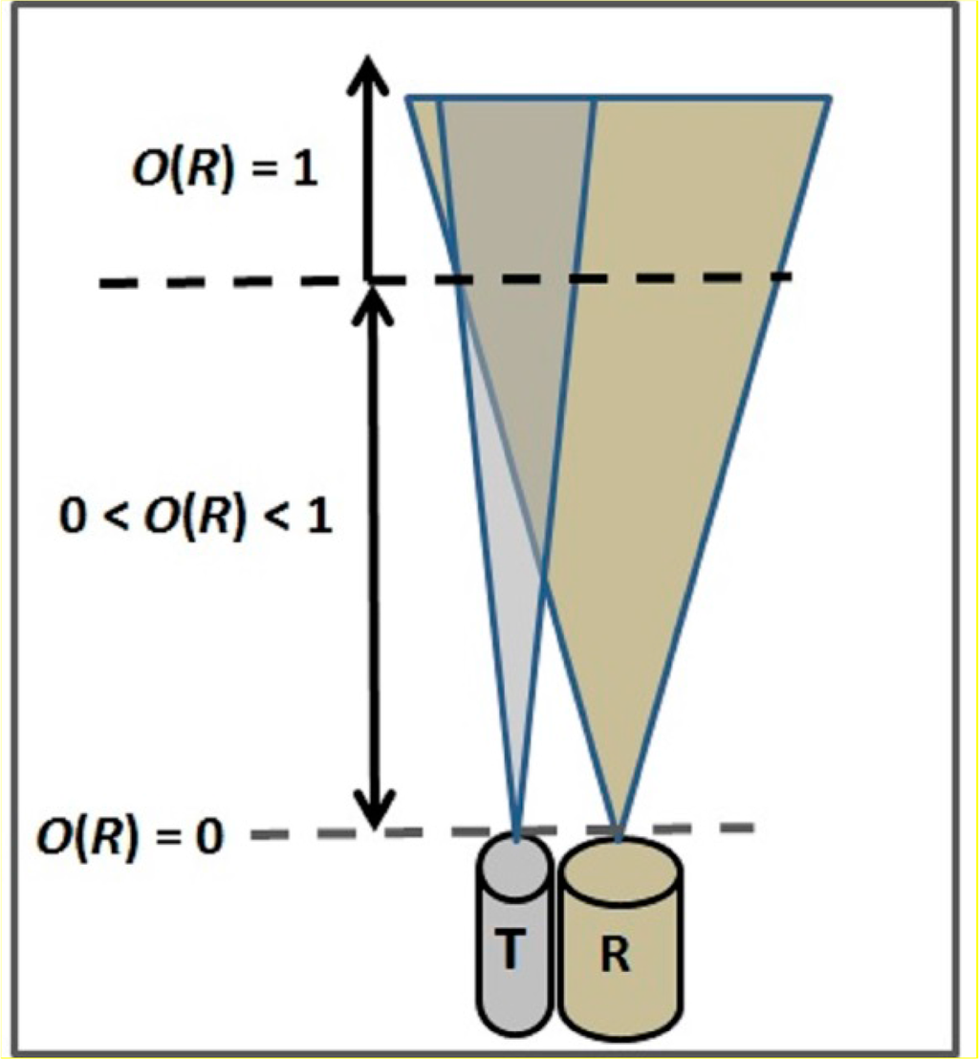
The Lidar Principle
Δt*=1/F_{D}, F_{D}=Signal sampling frequency (10-40 MHz→~GHz), Δz=range resolution
Δz=c (Δt*)/2
O(R): Overlap function
T: Laser (Emitter)
R: Telescope (Receiver)
Lidar signal S(z) ~ 1/z²
[Pal, S., Remote Sensing, 6, 8468-8493, 2014]

Slide 7
Lidar System Components
General physical properties:
LIDAR: robust, compact, low power consumption, stability (alignment/optics/mechanical structure), low weight (airborne/space borne systems), easy to operate, 24/7 operationality, remote control, low-cost maintenance-operation,
Housing: temperature-humidity controlled housing, compact with protection window, indirect solar radiation, weather-proof,
Transportable (special campaigns).
Transmitter (Laser):
Single-wavelength & polarized laser beam
High energy laser source
Wavelength: 0.266-10.6 um (several wavelengths - tunable for special cases)
High repetition rates (desired): several Hz to 20 some kHz.
Safety (laser Beam):
Eye-safe emission (exiting the protective window): Use convenient wavelengths + beam expander!
Operation Mode:
Day/nighttime, continuous, automated operation
Time resolution (several seconds to minutes)
Spatial resolution (~15-100 m or better, depending on height)
Signal Received:
Backscatter (molecules + aerosols)
Atmospheric Background correction (averaged signal at high ranges)
Electronic noise evaluation (use of pre-trigger)
Depolarization channels

Slide 8
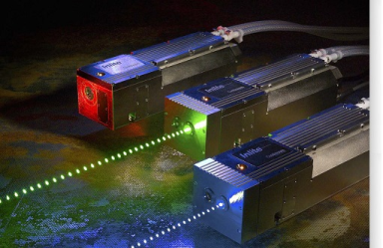
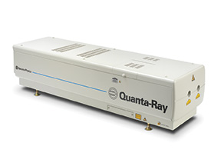
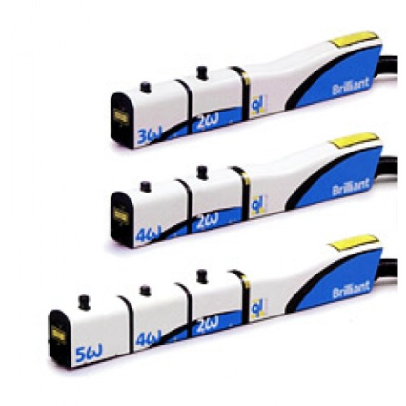
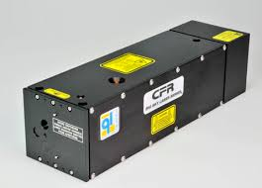
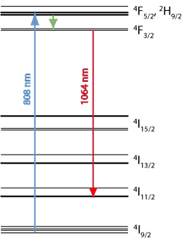
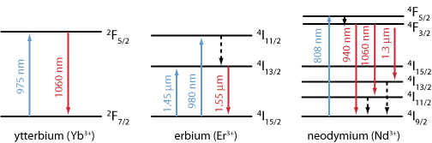
Lidar System Components
Laser Sources:
Typical laser sources: Nd:YAG (1.064um), XeCl (0.308um), Er:glass (1.54um),
Er:YAG (2.94um), Tm,Ho:YAG (2um), CO₂ (10.6 um), etc.
Excited energy state
Final energy state
Basic energy state
Blue: Pump optical beam (diode laser or flash lamp) Red: emitted laser beam

Slide 9
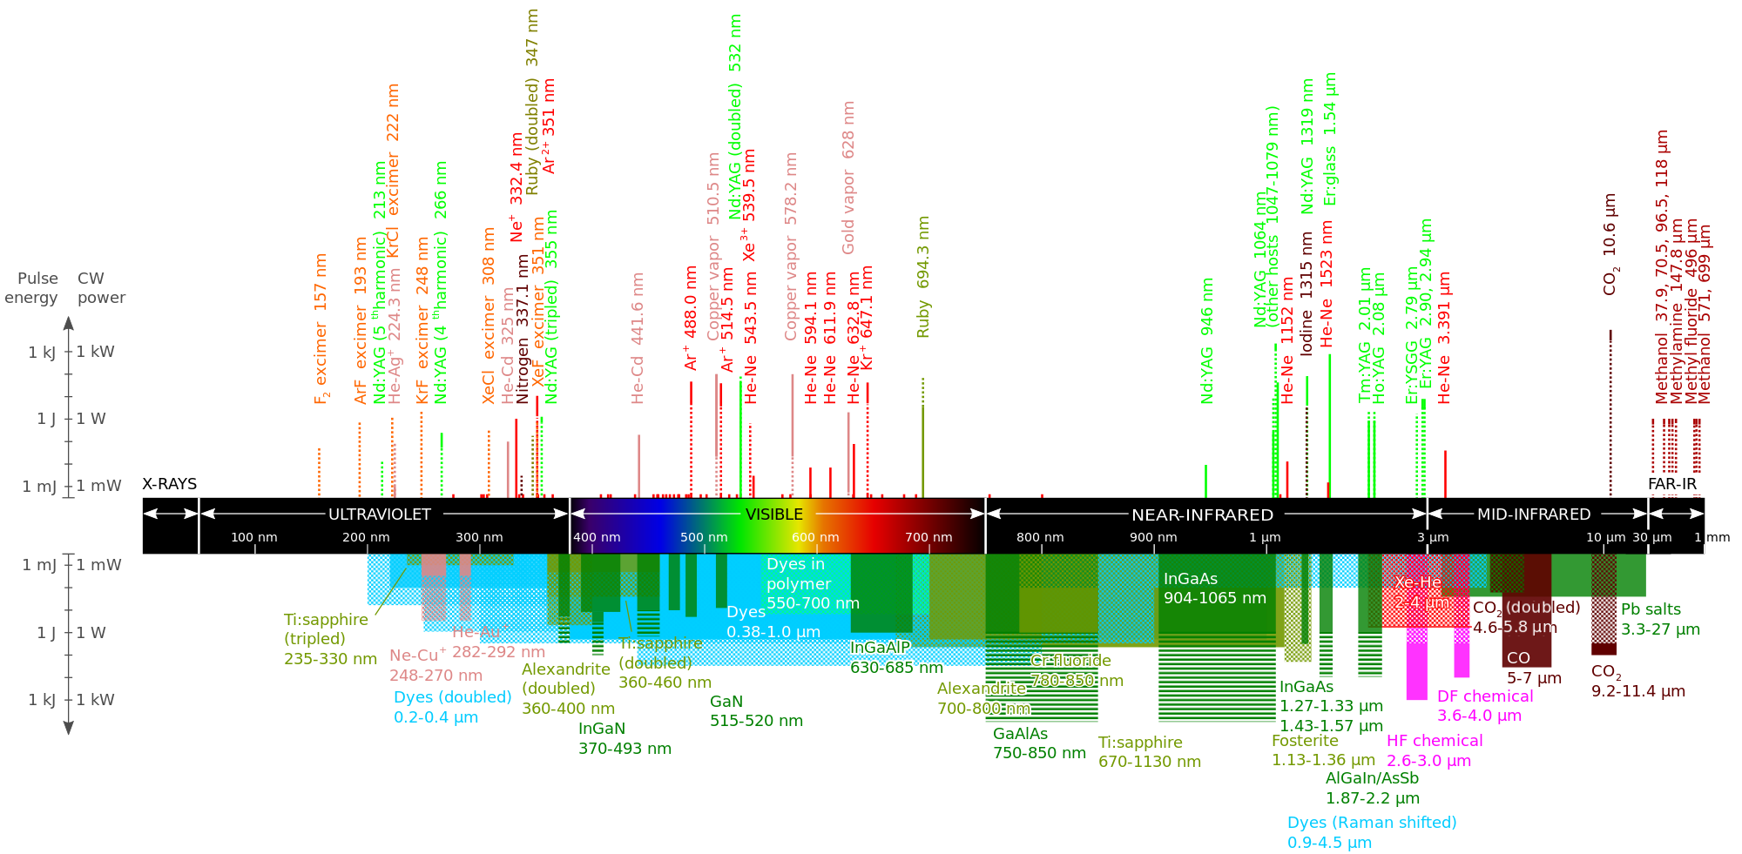
Lidar System Components
Laser Sources:
https://en.wikipedia.org/wiki/List_of_laser_types

Slide 10
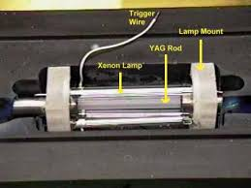

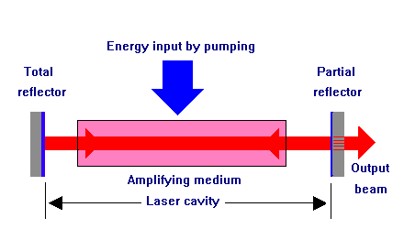


Lidar System Components
Laser Cavity (Type I-Solid state):
(100%) (~90-95%)
Laser crystals
Nanosecond pulses
Up to several Joules/pulse
Cavity reflectors

Slide 11
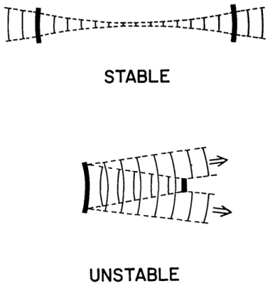
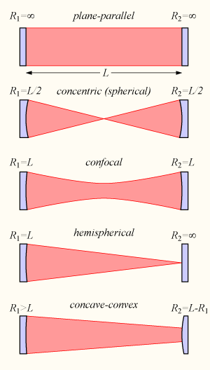


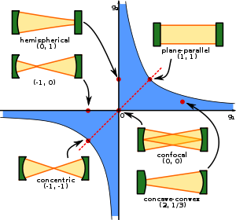
Lidar System Components
Laser Cavity (Type I-Solid state):
(Stability criterion)
Unstable:
After several round-trips the laser beams largely diverges
Stability region
Siegman (1986)

Slide 12
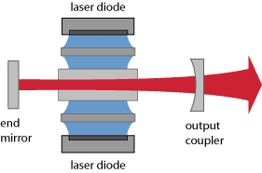
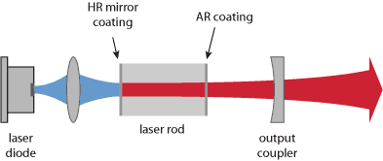
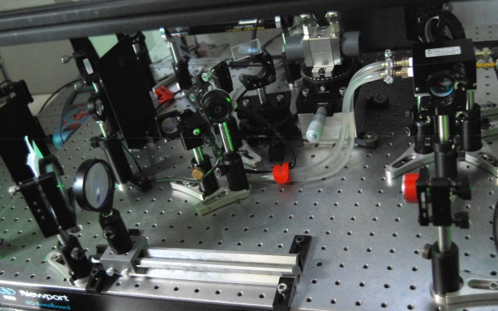
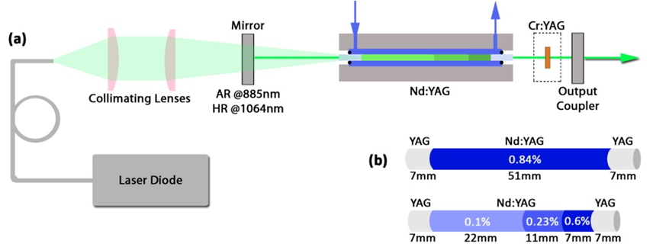
Lidar System Components
Laser Cavity (Type IA-Diode pumped solid state lasers):
(100%) (~90-95%)
Diode pumped multi-segmented Nd:YAG laser developed for European Space Agency @ NTUA
Nanosecond pulses
Up to several Joules/pulse
Evangellatos et al. (2013; 2014)

Slide 13
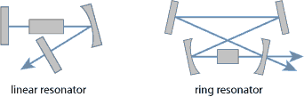
Lidar System Components
Laser Cavity:
Typical laser cavities: (multiple beams passages between 100% reflection mirrors and output couplers)
100% mirrors
100% mirrors
Active medium
Output coupler
Output coupler
Active medium
www.rp-photonics.com

Slide 14
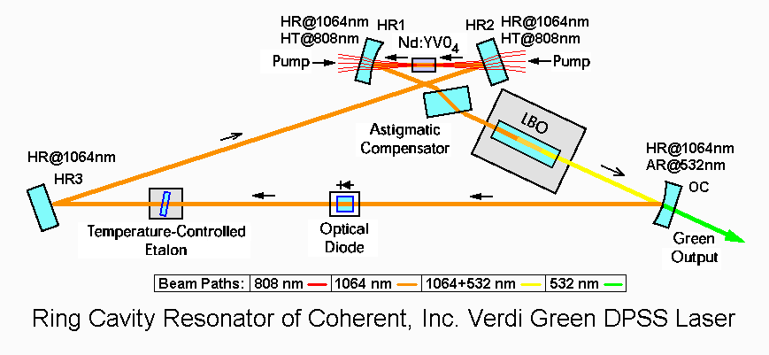
Lidar System Components
Laser Cavity:
Typical laser cavities: (multiple beams passages between 100% reflection mirrors and output couplers)
www.coherent.com

Slide 15
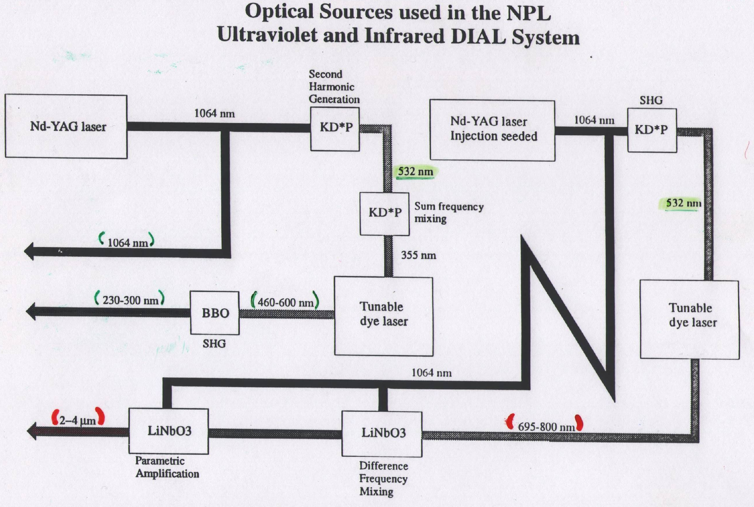
National Physical Laboratory (NPL), UK

Slide 16
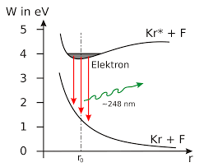
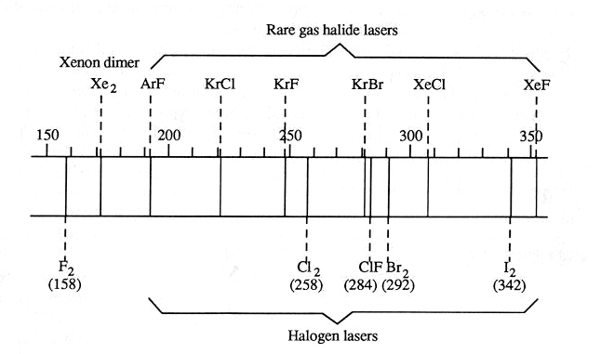
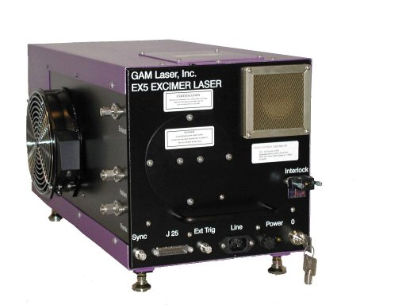
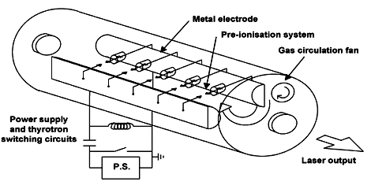
Lidar System Components
Laser Cavity (Type II-Gas lasers-Excimer lasers):
Excited dimer
(nm)
de.wikipedia.org
www.photonicsolutions.co.uk
Nanosecond pulses
Up to several Joules/pulse
O₃ measurements (KrF+Raman, XeCl)
http://www.twi-global.com/technical-knowledge/faqs/process-faqs/faq-what-is-an-excimer-laser/

Slide 17
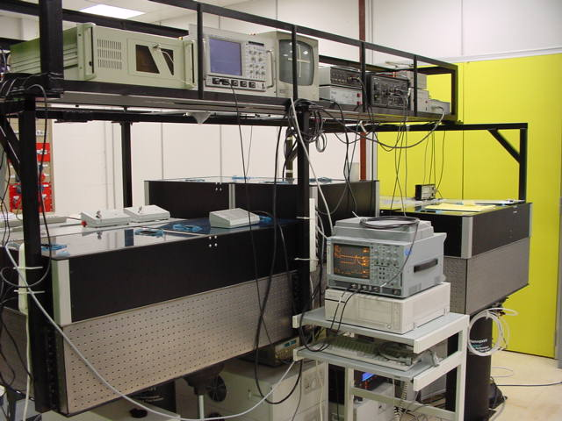

Lidar System Components
Laser Cavity (Type III-Femtosecond lasers):
Mode-locked lasers
Output laser beam
SA: Saturable absorber mirror
Gain medium
OC: output coupler
Mode locking: The laser resonator contains either an active element (an optical modulator) or a nonlinear passive element (a saturable absorber), which causes the formation of an ultrashort pulse circulating in the laser resonator.
Passive mode-locking: The gain medium compensates for losses, and the saturable absorber mirror (SA) enforces pulse generation. Each time the circulating pulse hits the output coupler mirror (OC), a pulse is emitted in the output.
SA with very low losses at high energies!
Femtosecond pulses
Up to several mJ/pulse
www.rp-photonics.com

Slide 18
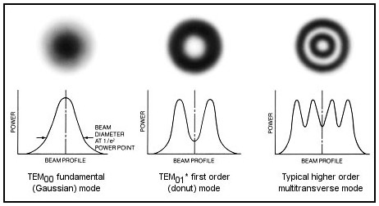
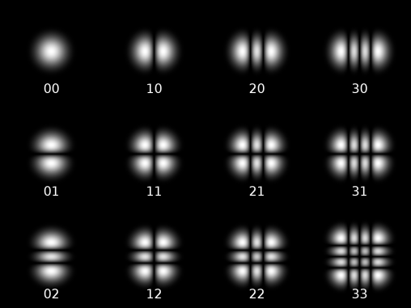
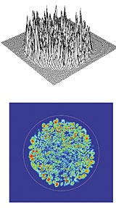
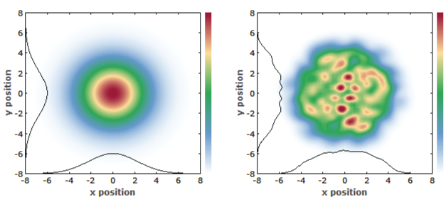
Lidar System Components
Laser Sources:
Transverse laser oscillating modes
(inside the laser cavity)
Multi-mode laser beams
https://www.rp-photonics.com/beam_profilers.html
www.spie.org
The laser energy is distributed over several oscillating “modes”, within the laser cavity
Applications:
- Detection of aerosols, molecules, clouds, etc.

Slide 19
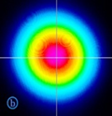
Lidar System Components
Laser Sources:
b) Mono/Single-mode (single frequency): Injection seeded lasers
The laser energy is distributed over one single several oscillating “mode”, within the laser cavity
Specs/Requirements:
Very narrow laser linewidth (<1 MHz)
[@1.54 um → 1.3 MHz Doppler shift 1 m/s wind velocity]
Applications:
Coherent transmitter in pulsed Doppler lidars (measurement of wind velocity + shear)
High Spectral Resolution Lidars-HSRL (aerosol backscatter-extinction, wind velocity + shear)
Temperature profiling, etc.
Evangellatos et al. (2013; 2014)

Slide 20
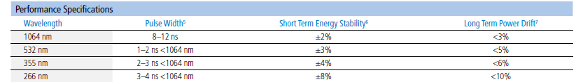

Lidar System Components
Common problems related to Laser Sources:
a) Beam power instability (e.g. 266 nm)
Source: Quanta Ray lasers (Spectra Physics)
b) Earth problems (a good earthing is required)
c) Stable input voltage is required
Laser Safety !

Slide 21
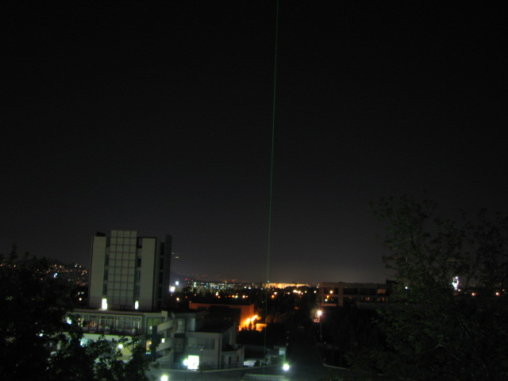


NATIONAL TECHNICAL UNIVERSITY OF ATHENS
FACULTY OF APPLΙED SCIENCES
DEPARTMENT OF PHYSICS
NATIONAL TECHNICAL UNIVERSITY OF ATHENS
FACULTY OF APPLΙED SCIENCES
DEPARTMENT OF PHYSICS
Athens, 02 05 10
NTUA Raman lidar system
Received : ~ 10^{m} photons
m ~ 0 – 10-15 (depending on distance)
Emitted : 10^{n} photons
n ~ 10-20

Slide 22
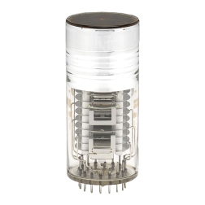
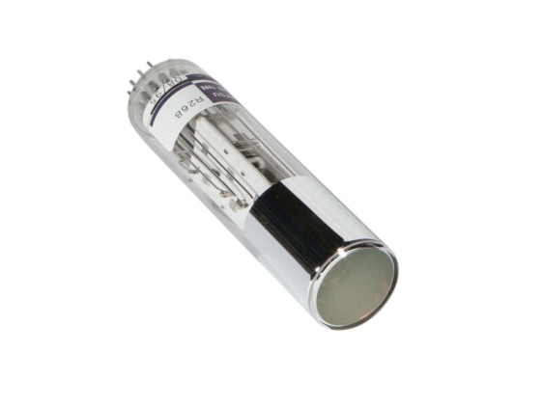

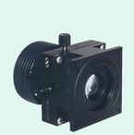
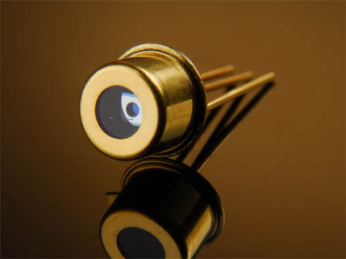
Lidar System Components
Photo-detectors (I)
PhotoMultiplier Tubes (PMTs)
Spectral Range: 110 nm – 1200 nm [lidars: 247 up to ~880 nm]
www.hamamatsu.com
Pros: Very good conversion efficiency
Cons: Only in the UV-VIS-beginning of NIR region
---------------------------------------------------------------------------------------------------------------------
Photo-detectors (II)
Avalanche PhotoDiodes (APDs)
Spectral Range:
APD-Si: 200 nm – 1100 nm
APD-Ge: 800-1550 nm
APD-InGaAs [lidars: 900-1500 nm]
Pros: Good conversion efficiency
Cons: Bulky, only in the near IR
www.hamamatsu.com, www.licel.com

Slide 23
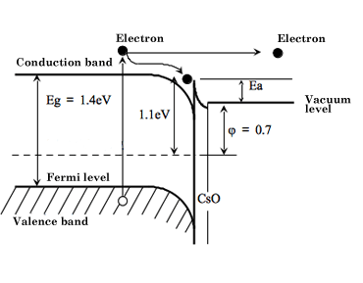
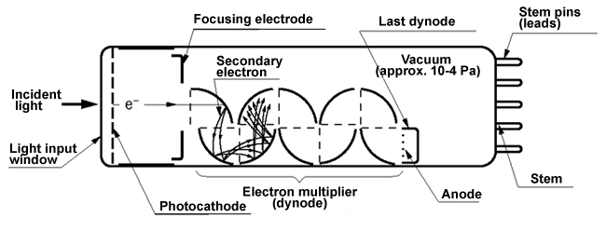
Lidar System Components
Photo-detectors (I)
PhotoMultiplier Tubes (PMTs) – Operating Principle
hν
Photocathode
Photocathode
www.hamamatsu.com

Slide 24
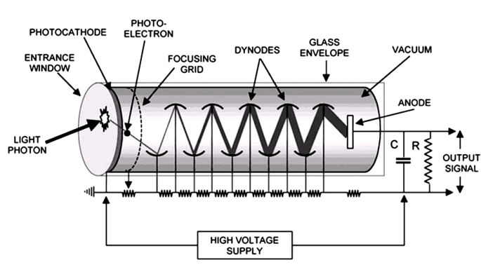
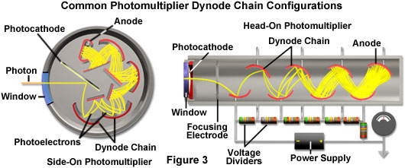
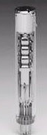
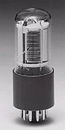
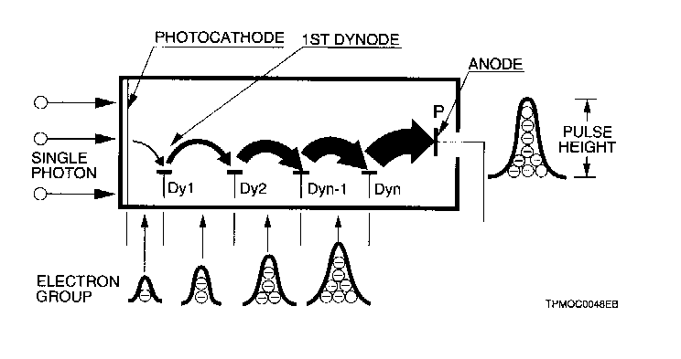
Lidar System Components
Photo-detectors (I)
PhotoMultiplier Tubes (PMTs) - Operating Principle for detecting pulsed (lidar) signals
www.olympusmicro.com
Side-on Head-on
High voltage divider circuit: divide the high voltage (800-1000 V) to the dynodes

Slide 25
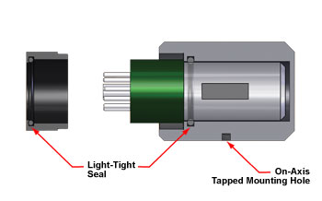
Lidar System Components
Photo-detectors (I)
PhotoMultiplier Tubes (PMTs) - Housing
A proper metallic housing (magnetic shielding) is required to protect the very sensitive
PMT from :
- external EM fields
- ambient temperature
- humidity
www.thorlabs.com

Slide 26
Lidar System Components
Photo-detectors (I)
PhotoMultiplier Tubes (PMTs) – Photocathode materials
The response of a PMT is specified by the photocathode sensitivity:
Quantum efficiency (%):
QE = Nphotoel. emitted by the photocathode/Number incident photons
Cathode radiant sensitivity (mA/W):
Photocurrent produced (mA) in response to the incident light power (W)
QE(%)=[124/λ(nm)] * radiant sensitivity (mA/W)
Cathode luminous sensitivity (μA/lm):
It relates the photocathode current to the human eye response
Current produced by an incident flux of 1 lumen from a Tungsten filament source (@2856 K)

Slide 27
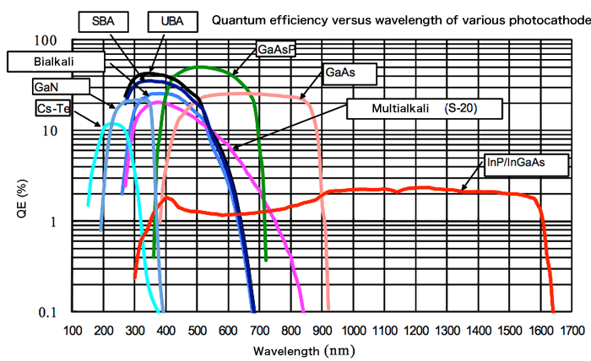

Lidar System Components
Photo-detectors (I)
PhotoMultiplier Tubes (PMTs) – Photocathode materials
The response of a PMT is specified by the photocathode sensitivity

Slide 28

Lidar System Components
Photo-detectors (I)
PhotoMultiplier Tubes (PMTs) - Photocathode

Slide 29

Lidar System Components
Photo-detectors (I)
PhotoMultiplier Tubes (PMTs) - Photocathode

Slide 30

Lidar System Components
Photo-detectors (I)
PhotoMultiplier Tubes (PMTs) - Photocathode
Spectral response: 1 photon (W) → anode (mA)
Gain: 1 photon → Nr photo-electrons (e⁻)

Slide 31

Lidar System Components
Photo-detectors (I)
PhotoMultiplier Tubes (PMTs) – Spatial uniformity
Hint: Always use doublet lenses in front of the PMTs
to direct the light into a diam ~ 3mm
Simeonov, et al., 1999.

Slide 32

Lidar System Components
Photo-detectors (I)
PhotoMultiplier Tubes (PMTs) – Spatial uniformity

Slide 33
Lidar System Components
Photo-detectors (I)
PhotoMultiplier Tubes (PMTs) – Anode collection space
The anode collection should have a suitable geometry for:
collecting all secondary electrons emitted by the last dynode
minimizing space charge effects to ensure linear response in pulse-mode operation
matching the anode impedance to the characteristic impedance of the output connection
(e.g, signal digitizer).
Anode sensitivity = Cathode sensitivity * PMT Gain

Slide 34

Lidar System Components
Photo-detectors (I)
PhotoMultiplier Tubes (PMTs) – Problems
- Never exceed the maximum average DC anode current (< 100 μΑ, or 5mV @50Ω input → Atmospheric background !)
Never exceed the maximum voltage ratings
After pulses (spurious pulses at low signal levels):
Main causes:
Luminous reactions (light emitted by the electrodes due to electron bombardment by high level light pulses)
Ionization of residual traces gases
PMT lifetime ~ 1/number of incident photons (N_{ip})
Change your PMT when its lifetime is exceeded !
Linearity – Non linearity (Nr of electrons collected ~ Nr of incident pulses)
PMT Linear region (output vs HV,
with const. light level input)
Kokkalis, PhD Thesis (2014)

Slide 35


Lidar System Components
Photo-detectors (I)
PhotoMultiplier Tubes (PMTs) – Photon Counting mode
Pulse pileup effect
A: Count loss from pulse pileup
B: Count gain from pulse pileup
Donovan et al. (1993)

Slide 36

Lidar System Components
Photo-detectors (I)
PhotoMultiplier Tubes (PMTs) – Photon Counting mode
Photon counting regime:
Low light level: PMT responses linearly (the output signal is proportional to the incident
light intensity),
High light level: PMT responses NON-linearly (the output signal is NOT proportional to the
Incident light intensity) → overlapping of light pulses (pulse pileup effect)
High light level
Low light level

Slide 37




Lidar System Components
Photo-detectors (II)
Avalanch PhotoDiodes (APDs)
1) Incident photons are absorbed
2) Electrons and holes are produced
(p⁻ region)
3) Electrons are accelerated (in the absorption region), thanks to E(x),
collide with valence e⁻ and, thus, produce free electrons (p region)
4) Electrons are accelerated, in the avalanche region, thanks to E(x) [100 kV/cm) , and produce secondary e⁻ (depleted region) through impact ionization.
Reverse bias electric field
Avalanche region
e^{- →}
Absorption
Depleted
region
Photons
Marcu et al., 2014
www.wikiwand.com/de/Avalanche-Photodiode

Slide 38

Lidar System Components
Photo-detectors (II)
Avalanch PhotoDiodes (APDs)
Spectral response: 1 photon (W) → anode (A)

Slide 39
Lidar System Components
Photo-detectors (I-II)
PMTs - APDs– Anode dark current
Anode dark current (in total darkness the PMT still produces a small output current)
Ohmic leakage currents (leakage currents between electrodes and the glass)
Thermionic current (thermionic emission of electrons from the photocathode)
NTUA, EOLE data

Slide 40

Signal Detection
Analog mode
Photon counting mode
Lidar Signal
Lidar Signal
www.hamamatsu.com
Analog mode
Photon counting mode
PMT output →
www.licel.com
Analog to Digital Conversion (12-, 14-, 16-bit Digitizers)

Slide 41

Signal ADC & Digitization/Sampling (Analog signals)
Δt*=1/F_{D}, F_{D}=Signal sampling frequency (10-40 MHz → ~ GHz)
Example:
F_{D}=10 MHz → Δt*=100 ns → Δz=15 m
F_{D}=20 MHz → Δt*=50 ns → Δz=7.5 m
F_{D}=40 MHz → Δt*=25 ns → Δz=3.75 m
F_{D}=1 GHz → Δt*=1 ns → Δz=0.15 m
Lidar Signal

Slide 42

Signal ADC & Digitization/Sampling (Analog signals)
Rule of thumb: Max Analog signal/2, e.g. for 40 mV input signal → signal range 100 mV
Lidar Signal
www.licel.com

Slide 43

Signal (Photon Counting mode)
Lidar Signal
Photon counting mode
(Dead time correction)
www.licel.com
For each PMT a dead time (τ_{d}) has to be measured !!
Example:
Alt= 0.5 km → N_{meas}=50 MHz, τ_{d}=3.8 ns → S_{true}=61.75 MHz
Alt= 3 km → N_{meas}=10 MHz, τ_{d}=3.8 ns → S_{true}=10.4 MHz
All photon counting signals (low altitudes) have to me corrected for dead time (N_{meas}>10MHz)

Slide 44

Signal (Photon Counting mode)
Lidar Signal
Photon counting mode (Dead time correction)
Barbosa et al., 2014

Slide 45

Examples (I)
After a strong backscatter (from cloud) no useful signal remains

Slide 46

Examples (II)
Signal NOT USEFUL > 7 km
1064 nm (analogue)
Rayleigh fit

Slide 47

Examples (III)
PROBLEM : (not stable signal > 7 km height)
Raw lidar signal with strong dust layer
1064 nm
Problem due to not good earthing or too high HV

Slide 48

Examples (IV)
Raw lidar signal with dust layer
1064 nm
Problem due to not good earthing or too high HV

Slide 49

Examples (V)
Noise file (dark file)
1064 nm

Slide 50
REFERENCES
References – Books/Papers
BOOKS – Journal Papers
Barbosa, H., et al., A permanent Raman lidar station in the Amazon: description, characterization and first results, Atmos. Meas. Tech., 7, 1745–1762, 2014.
Baudis, L., et al., Measurements of the position-dependent photo-detection sensitivity of the Hamamatsu R11410 and R8529 photomultiplier tubes, arXiv:1509.04055v1, 2015.
Evangelatos, C., P. Bakopoulos, G. Tsaknakis, D. Papadopoulos, G. Avdikos, A. Papayannis, G. Tzeremes, Continuous wave and passively Q-switched Nd:YAG laser with a multi-segmented crystal diode-pumped at 885 nm, Applied Optics, 52, 8795-8801, 2013.
Evangelatos, C., G. Tsaknakis, P. Bakopoulos, D. Papadopoulos, G. Avdikos, A. Papayannis, and G. Tzeremes, Q-switched laser with multi-segmented Nd:YAG crystal pumped at 885 nm for remote sensing, Photonics Technology Letters 26, 1890-1893, 2014.
Fiocco, G., and Smullin, L.D., Detection of scattering layers in the upper atmosphere by optical radar. Nature, 199, 1275–1276, 1963.
Grath, A., et al., Injection-seeded single frequency, Q-switched Er:glass laser for remote sensing, Appl. Opt., 5706-5709, 1998.
Hulburt, E.O., Observations of a searchlight beam to an altitude of 28 kilometers. J. Opt. Soc. Am., 27, 344-377, 1937.
Kokkalis, P., Study of the tropospheric aerosols using ground-based and space-borne techniques – Measurement analysis and statistical processing, Ph.D. Thesis (in Greek), NTUA, Greece, 2014.
Marcu, L., et a., Fluorescence Lifetime Spectroscopy and Imaging: Principles and Applications in Biomedical Diagnostics, 570 pp., CRC Press, 2014.
McGrath, A., Munch, J., Smith, G., Veitch, P., Injection-seeded, single frequency, Q-switched Er:glass laser for remote sensing, Appl. Opt., 37, 5706-5709, 1998.
Measures, R. M.: Lidar Remote Sensing: Fundamentals and Applications, Krieger Publishing Company, Malabar, Florida, 2nd Edn., 1992.
Müller, J. W.: Dead-time problems, Nucl. Instrum. Methods, 112, 47–57, doi:10.1016/0029-554x(73)90773-8, 1973.
Newsom, R. K., Turner, D. D., Mielke, B., Clayton, M., Ferrare, R., and Sivaraman, C.: Simultaneous analog and photon counting detection for Raman lidar, Appl. Optics, 48, 3903–3914, doi:10.1364/AO.48.003903, 2009.
Siegman, A., Lasers, University Science Books, 1986.
Simeonov, V., et al., Influence of the photomultiplier tube spatial uniformity on lidar signals, Appl. Opt., 38, 5186-5190, 1999.
Stanford Research Systems. In Signal Recovery with Photomultiplier Tubes, Photon Counting, Lock-In Detection, or Boxcar Averaging?, Stanford Research Systems, AN 4, 15 pp., 1995.

Slide 51
References – Websites
www.hamamatsu.com
www.coherent.com
www.licel.com
www.olympusmicro.com
www.rp-photonics.com/beam_profilers.html

